Slide 1
Overview of findings of AR5 WGIII
Youba Sokona
Co-Chair, IPCC Working Group III
University of San Marcos, Lima, Peru
8 December 2014

Slide 2
IPCC reports are the result of extensive work of many scientists from around the world.
1 Summary for Policymakers
1 Technical Summary
16 Chapters
235 Authors
900 Reviewers
More than 2000 pages
Close to 10,000 references
More than 38,000 comments

Slide 3
GHG emissions growth has accelerated despite reduction efforts.
Notes:
The exploration of the map of mitigation responses in Working Group 3, starts with the observation of how GHG emission trends have developed over time – particularly over the last decade.
This assessment shows that GHG emission growth has accelerated recently despite a growing number of climate policies at different levels. [This does not necessarily mean that these efforts have been ineffective – there is no clear evidence on the effectiveness of mitigation policies]

Slide 4
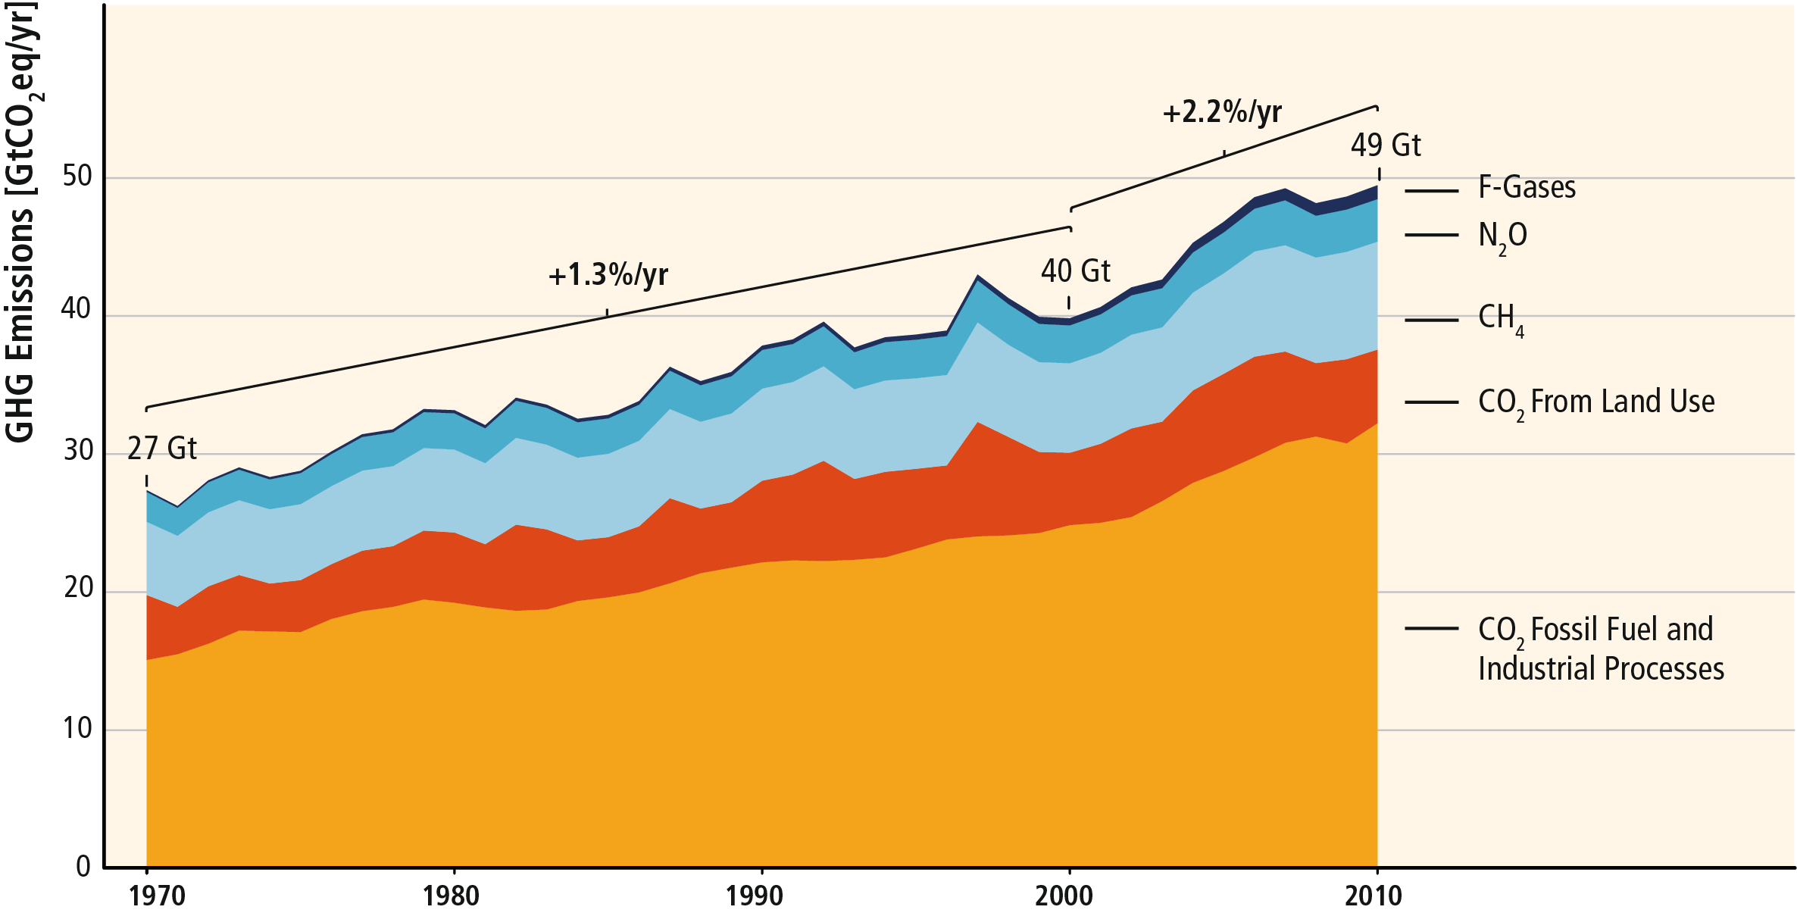
GHG emissions growth between 2000 and 2010 has been larger than in the previous three decades.
±4.5Gt
Notes:
GHG emissions have grown faster between 2000 and 2010 than in the previous three decades.
While the average annual increase in GHG emissions has been 1.3%/yr between 1970 and 2000, this was 2.2%/yr between 2000 and 2010.
In 2010 GHG emission reached 49Gt CO2eq with an uncertainty of roughly 10%.
The largest share of GHG emissions is CO2 from fossil fuel production and industrial processes.

Slide 5
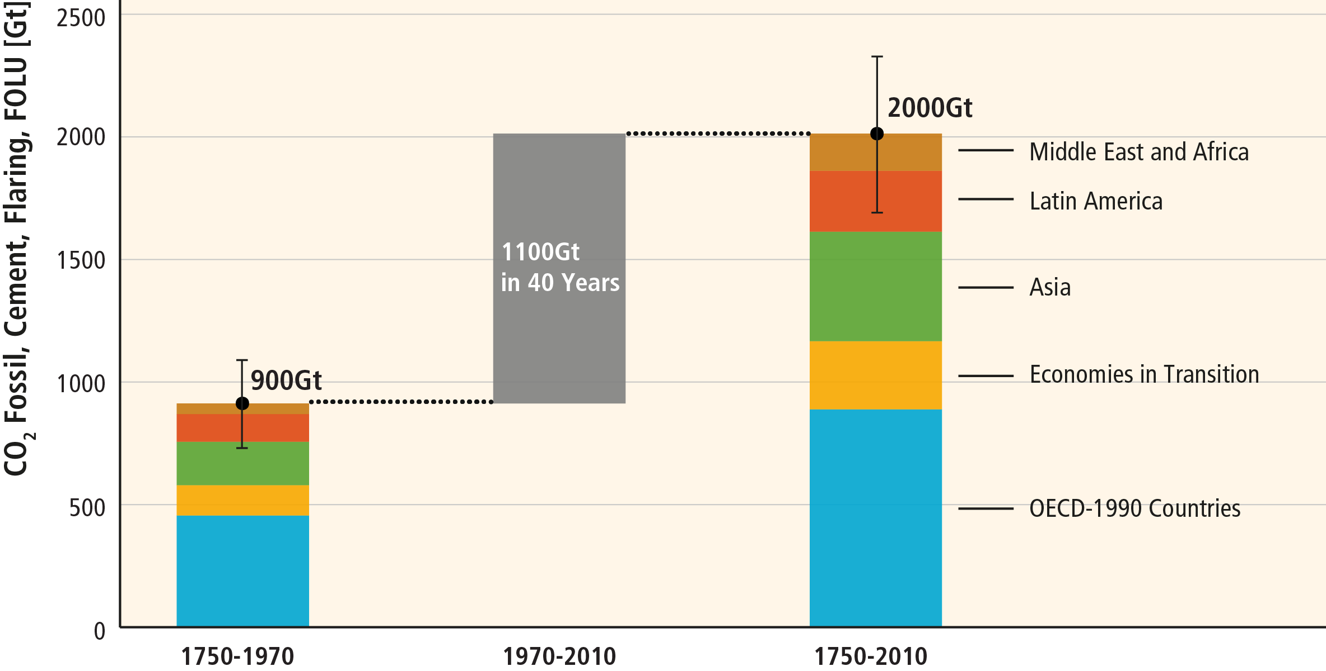
About half of cumulative anthropogenic CO₂ emissions between 1750 and 2010 have occurred in the last 40 years.
Notes:
More than half of the historic CO2 emission growth has occured during the last 40 years.
While historically most emission growth has occured in industrialized countries, most of the recent emission growth has been in emerging economies in Asia and Latin America.

Slide 6
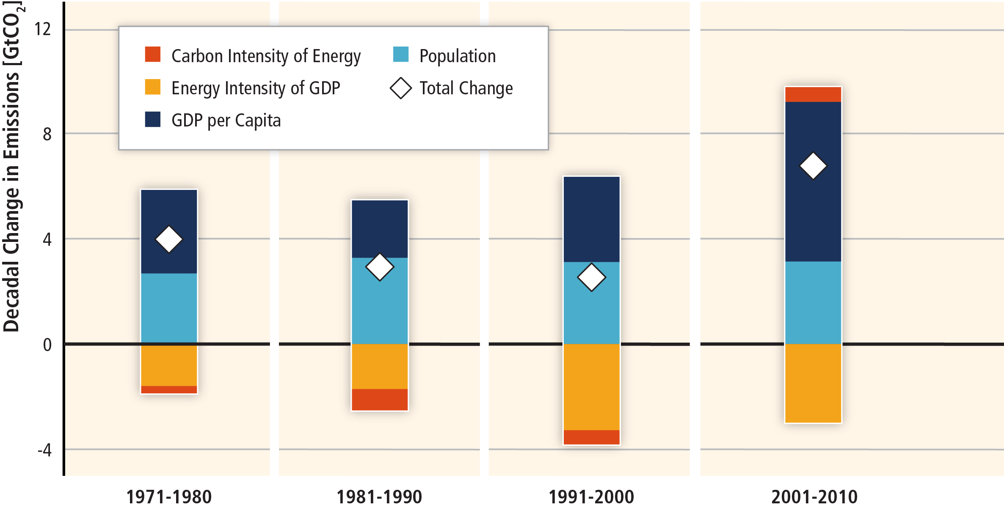
Most of the recent GHG emission growth has been driven by growth in economic activitiy.
Notes:
Globally, economic and population growth continue to be the most important drivers of increases in CO₂ emissions from fossil fuel combustion. The contribution of population growth between 2000 and 2010 remained roughly identical to the previous three decades, while the contribution of economic growth has risen sharply (high confidence). Between 2000 and 2010, both drivers outpaced emission reductions from improvements in energy intensity.

Slide 7
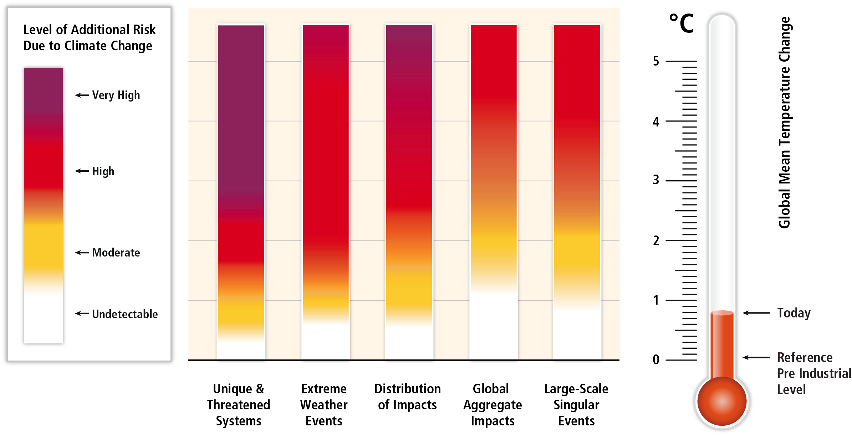
Without additional mitigation, global mean surface temperature is projected to increase by 3.7 to 4.8°C (2.5 - 7.8 °C) over the 21st century.
Notes:
For this assessment, about 900 mitigation and 300 baseline scenarios have been collected in a database based on published integrated models. These scenarios are consistent with very different levels of atmospheric CO2eq concentrations in 2100.
Baseline scenarios, those without additional mitigation, result in global mean surface temperature increases in 2100 from 3.7 to 4.8°C compared to pre-industrial levels.
The Working Group 2 assessment highlights that this may be a world that involves high and very high climate risks.

Slide 8
Limit warming to 2°C relative to pre-industrial levels involves substantial technological, economic and institutional challenges.
Notes:
But can we do anything about this?
Large discussions on how dangerous interference with the climate can be avoided. The international community has agreed that this may require limiting global mean temperature increase to about 2°C .
Our assessment shows that there are a range of mitigation pathways consistent with a 2°C but that this substantial technological, economic and institutional challenges.
But reaching less ambitious goal still require a substantial deviation from baseline.

Slide 9
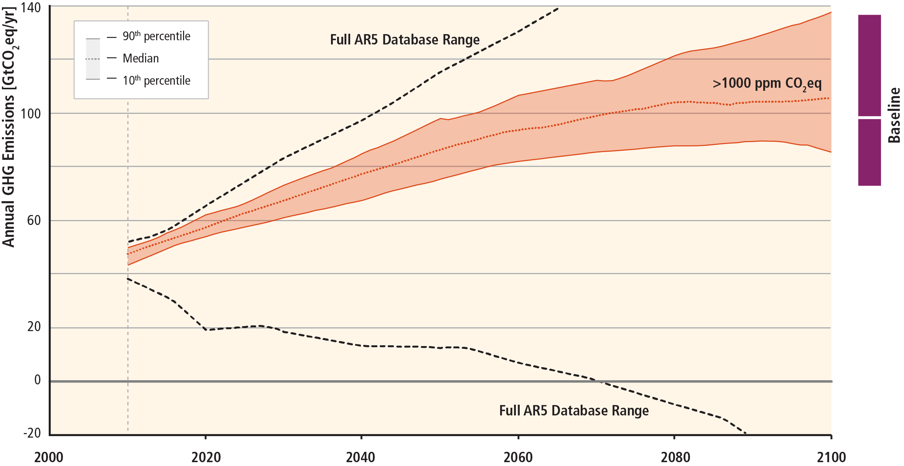
Stabilization of atmospheric concentrations requires moving away from the basline – regardless of the mitigation goal.

Slide 10
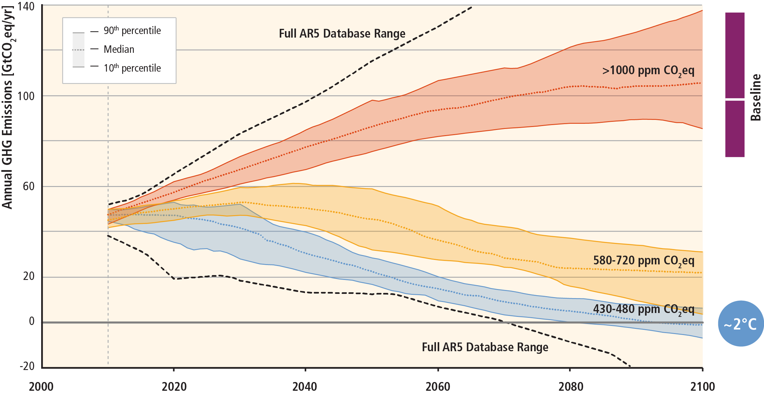
Stabilization of atmospheric concentrations requires moving away from the basline – regardless of the mitigation goal.
Notes:
A breadth of scenarios has been published that is consistent with 2°C goal.
This scenarios are characterized by a whole set of technological, economic and institutional challenges. They requires:
Fundamental transformation of the energy systems and potentially land
40-70% emission reductions by 2050 and emissions are reduced towards zero or below by the end of the century.

Slide 11
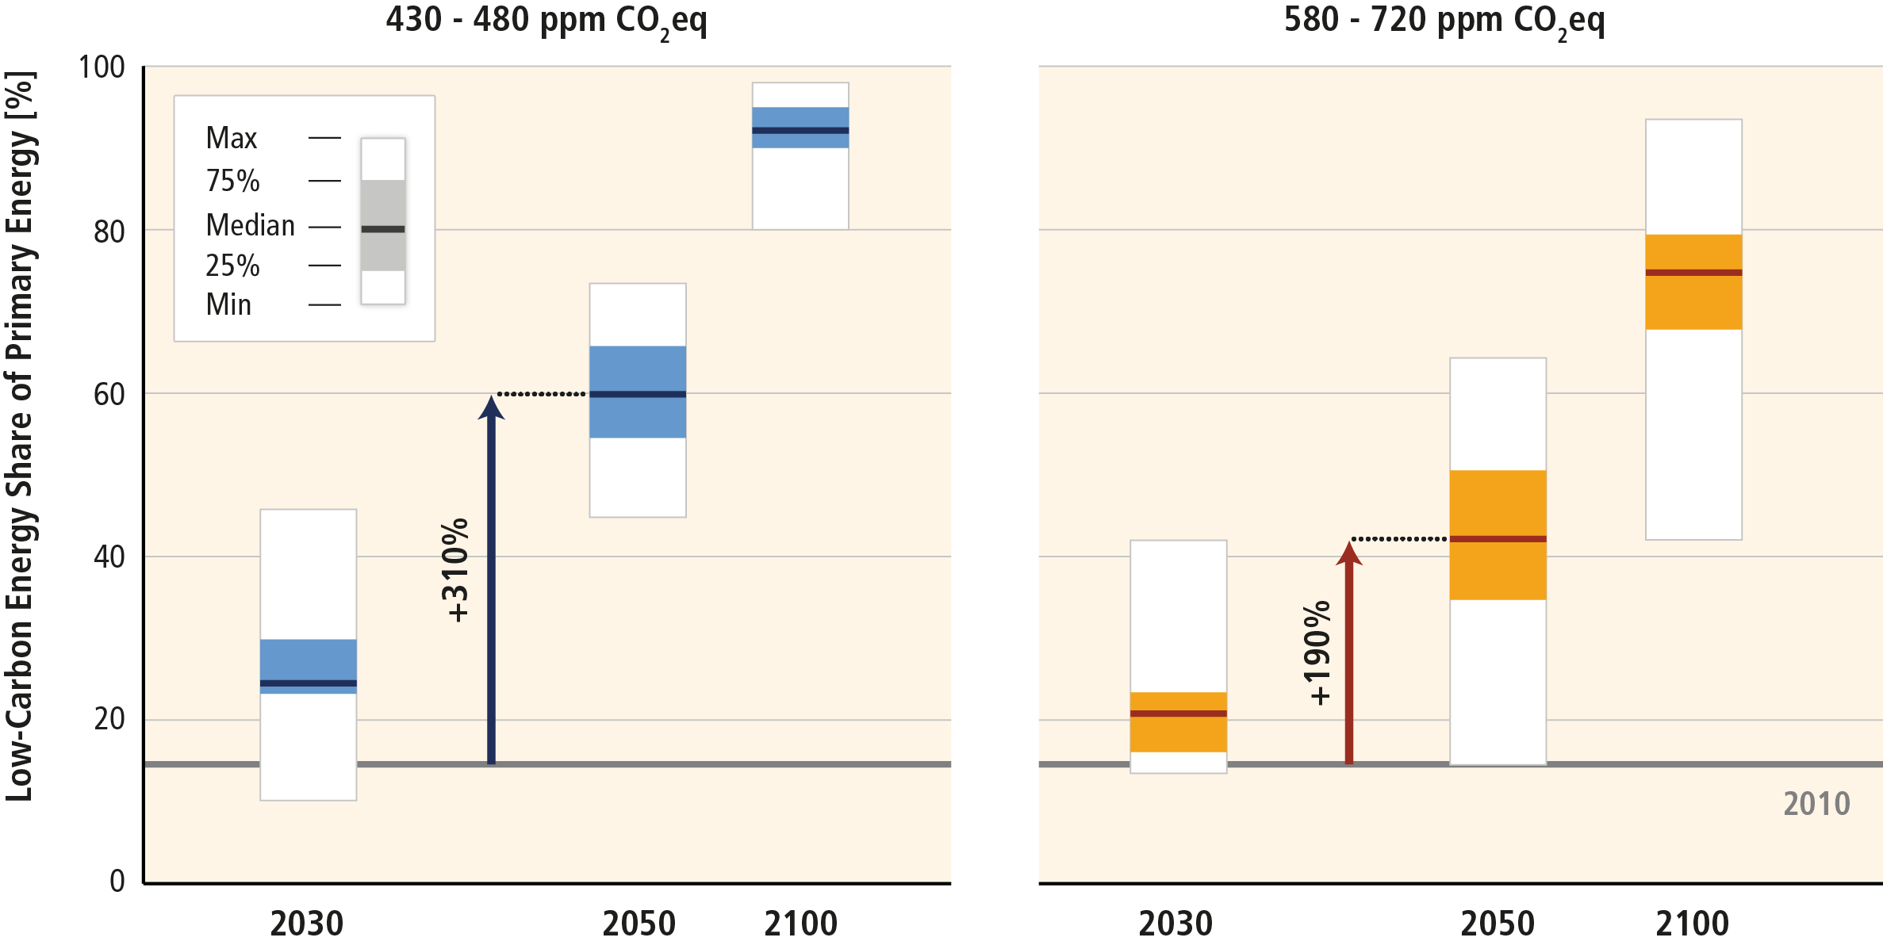
Mitigation involves substantial upscaling of low carbon energy.
Notes:
One of the fundamental challenges of moving away from the baseline is the upscaling of zero- and low carbon technologies.
Scenarios consistent with a 2 degree goal (430-480ppm), requires a quadrupling of the share of zero and low carbon energy by 2050 compared to 2010.
If we want to achieve a 3 degre goal, the low carbon energy share still need to be trippled.

Slide 12
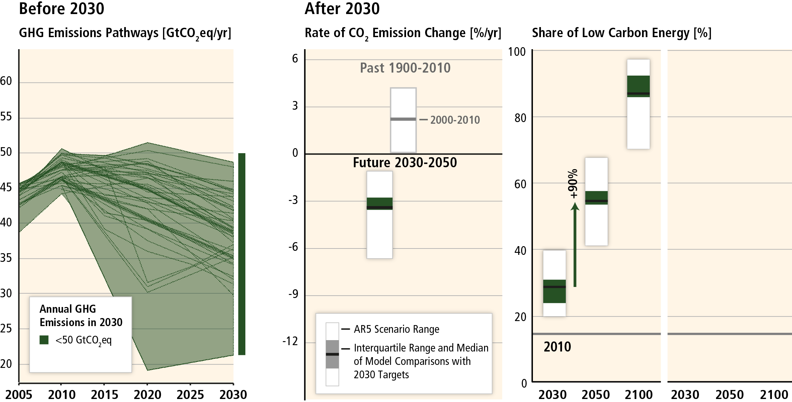
Delaying mitigation increases the difficulty and narrows the options for limiting warming to 2°C.
Notes:
One of the key insights from this assessment is how what we do in the short term determines the future challenge in achieving a certain climate goal.
This slides shows only scenarios broadly consistent with a 2 degree goal.
In cost-effective scenarios with immediate, stringent mitigation policies, GHG emissions are not growing beyond today‘s level.
To achieve emission reductions between 2030 and 2050, the share of low carbon energy needs to be doubled.

Slide 13
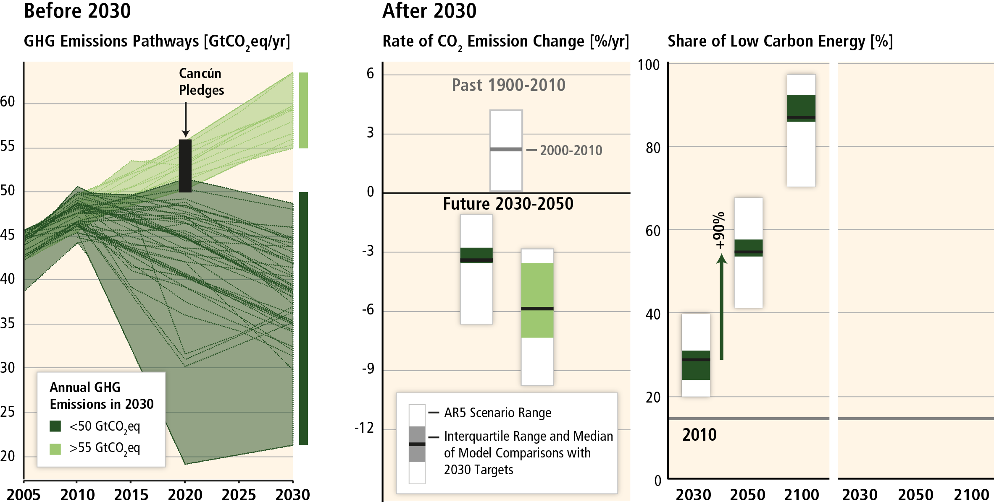
Delaying mitigation is estimated to increase the difficulty and narrow the options for limiting warming to 2°C.
Notes:
If we follow emission pathways where emissions continue to grow by 2030, the challenges of meeting a 2 degree target grow sustantially.
Instead of required global emission reductions of 3%/yr, we need reductins of 6% per year.

Slide 14
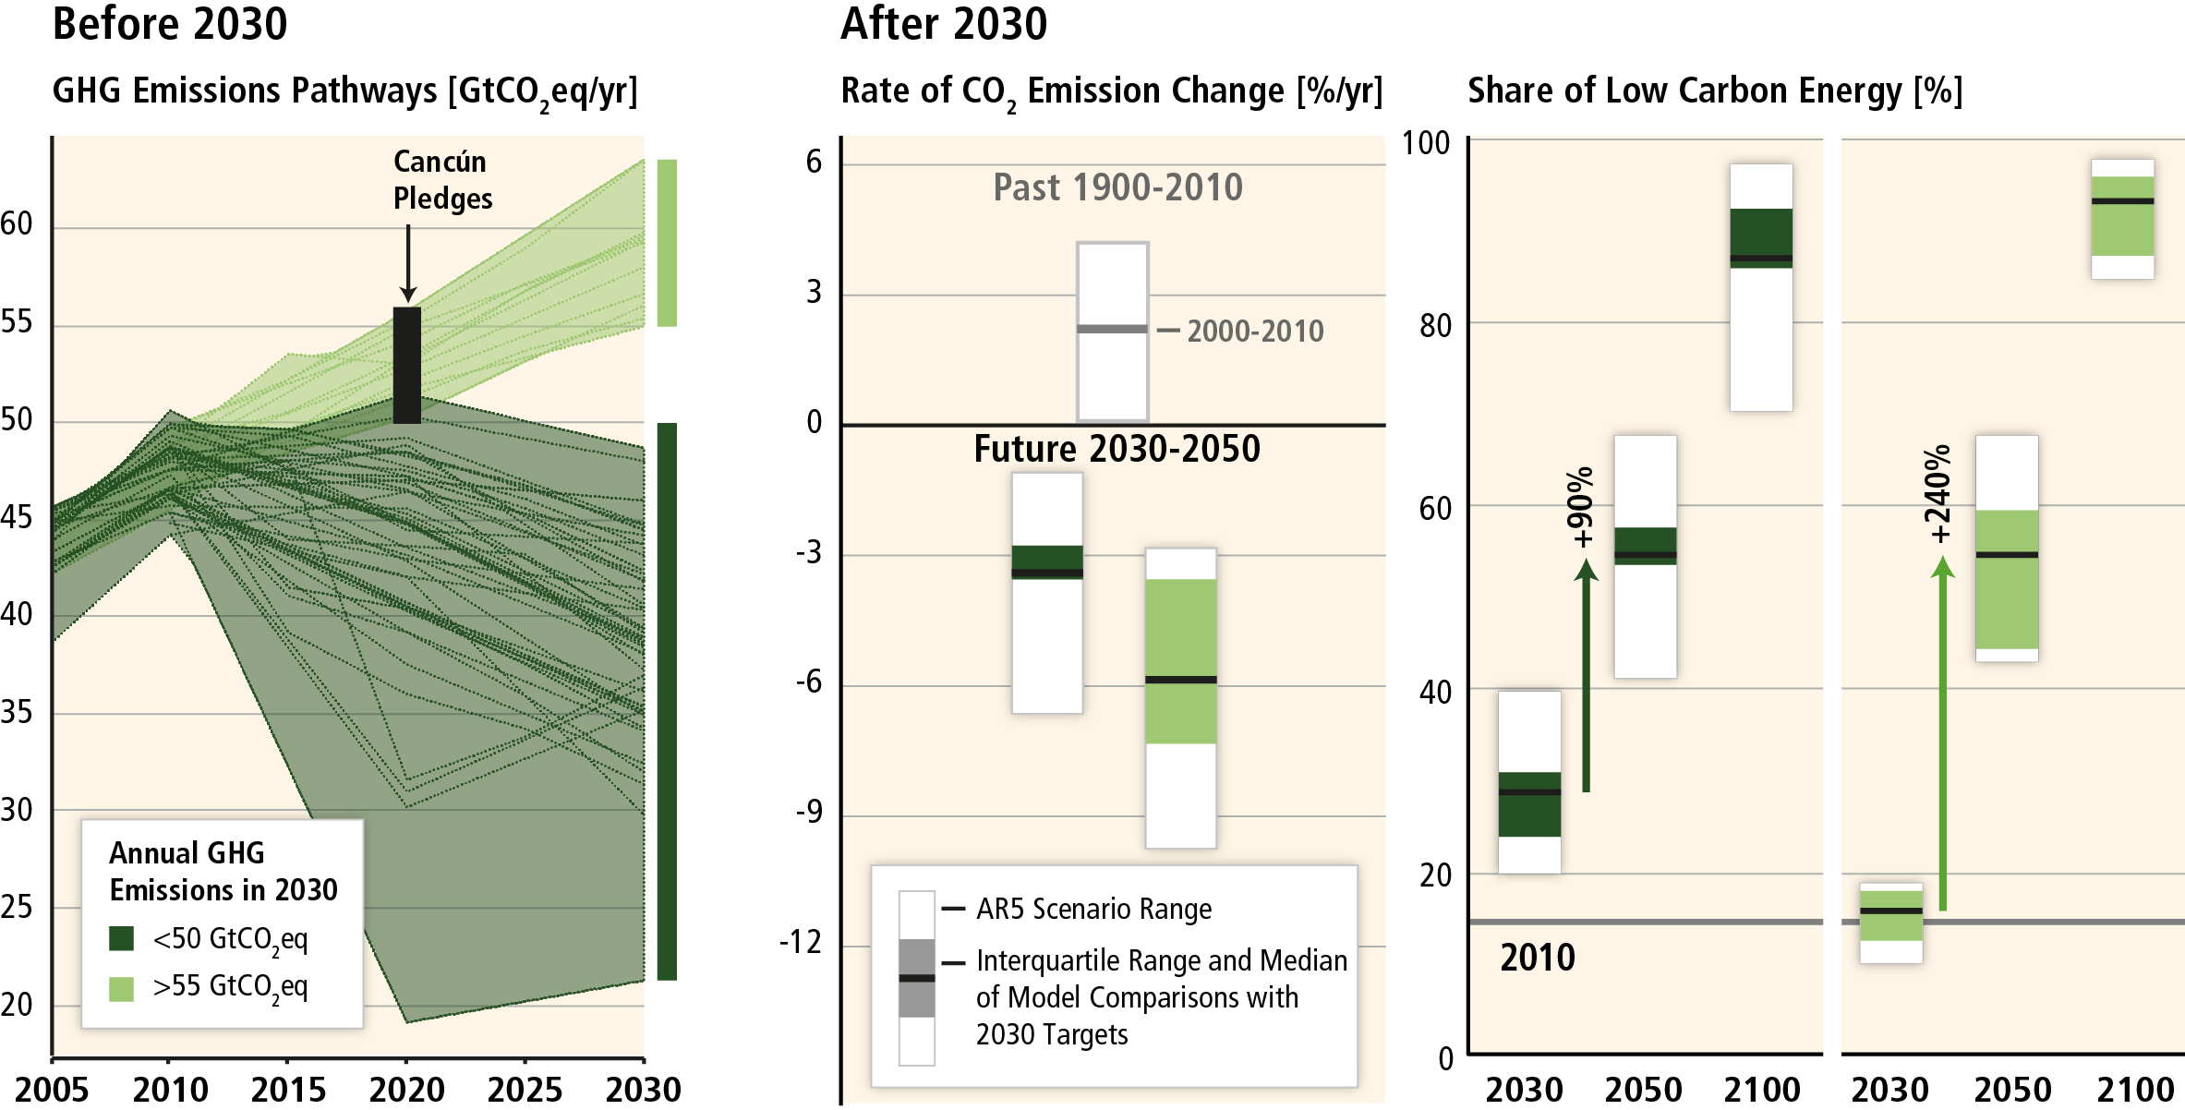
Delaying mitigation is estimated to increase the difficulty and narrow the options for limiting warming to 2°C.
Current Cancun Pledges imply increased mitigation challenges for reaching 2°C.
Notes:
Instead of a doubling of the low carbon energy share between 2030 and 2050 we need to more than triple it.
Such a pathway of increased mitigation policies is also more economically costly.
The emission pathway of the Cancun pledges require facing such increased mitigation challenges.

Slide 15
Mitigation cost estimates vary, but do not strongly affect global GDP growth.

Slide 16
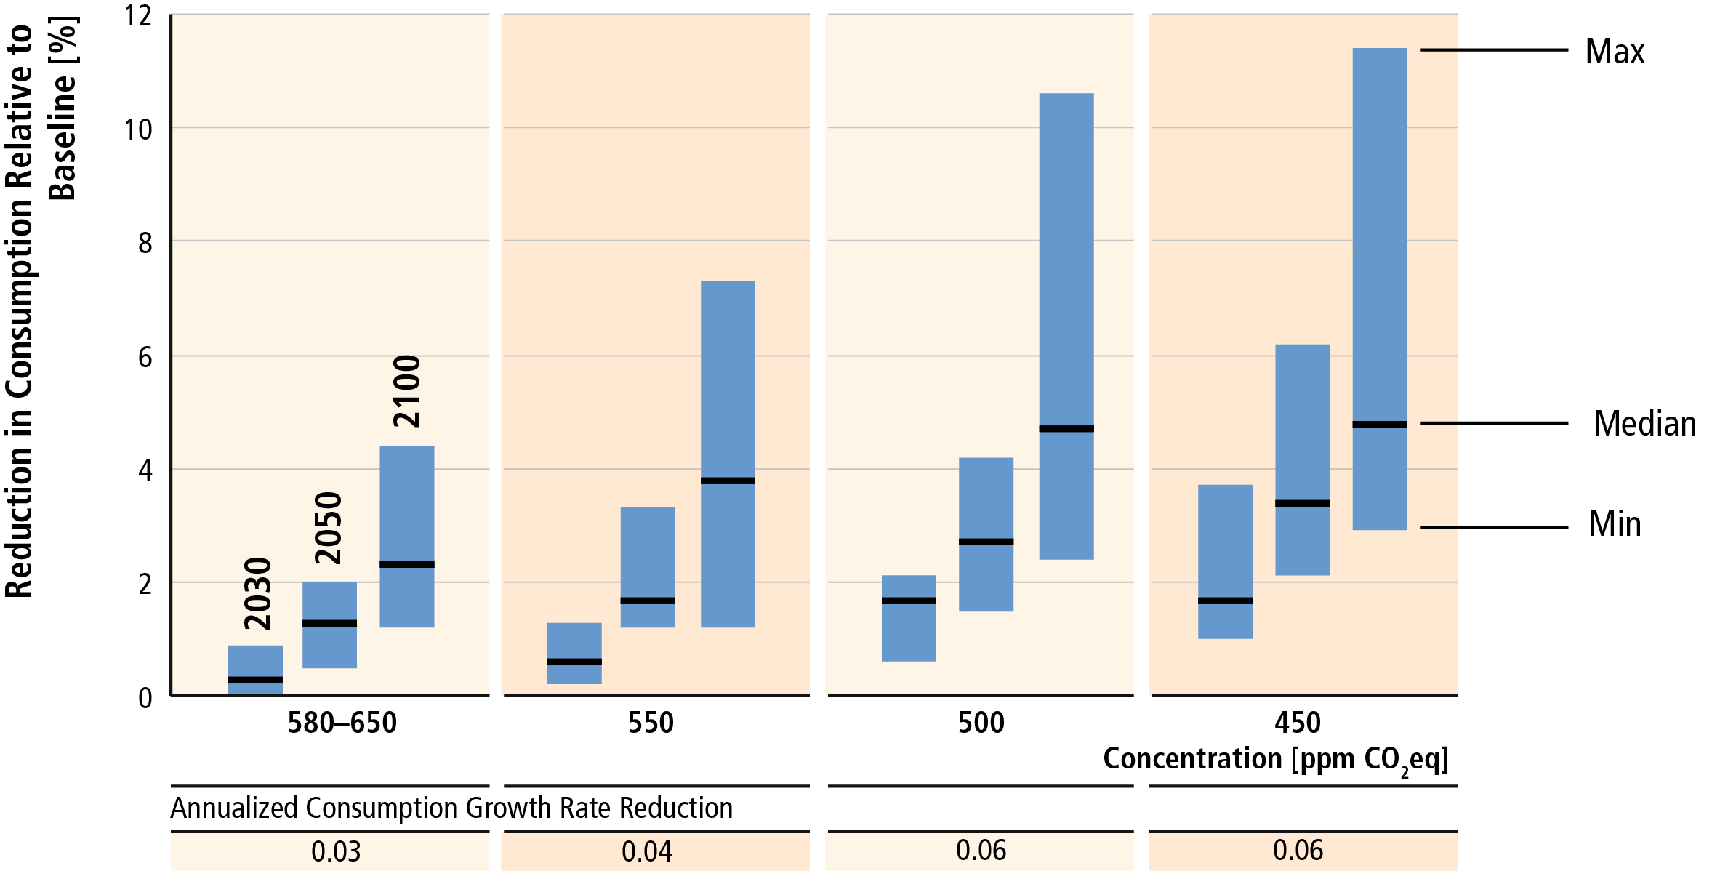
Global costs rise with ambition of mitigation goal
Notes:
One of the key results coming from WG3 reports is on the costs of mitigation.
This analysis highlights the uncertainties in evaluating future costs and the important influence of normative choices made in this analysis.
It stresses that climate change is certainly not a free lunch, but it also does not cost the world to safe the planet. Mitigation consistent with the 2°C goal involves annualized reduction of consumption growth by 0.04 to 0.14 (median: 0.06) percentage points over the century relative to annualized consumption growth in the baseline that is between 1.6% and 3% per year.
Costs increase with stringency of climate policy, delays in mitigation and technology constraints.

Slide 17
Ambitious mitigation scenarios require a full decarbonisation of energy supply.
Energy demand reductions can help to reduce emissions in the medium term and are key for hedging supply side risks in the long-run.

Slide 18
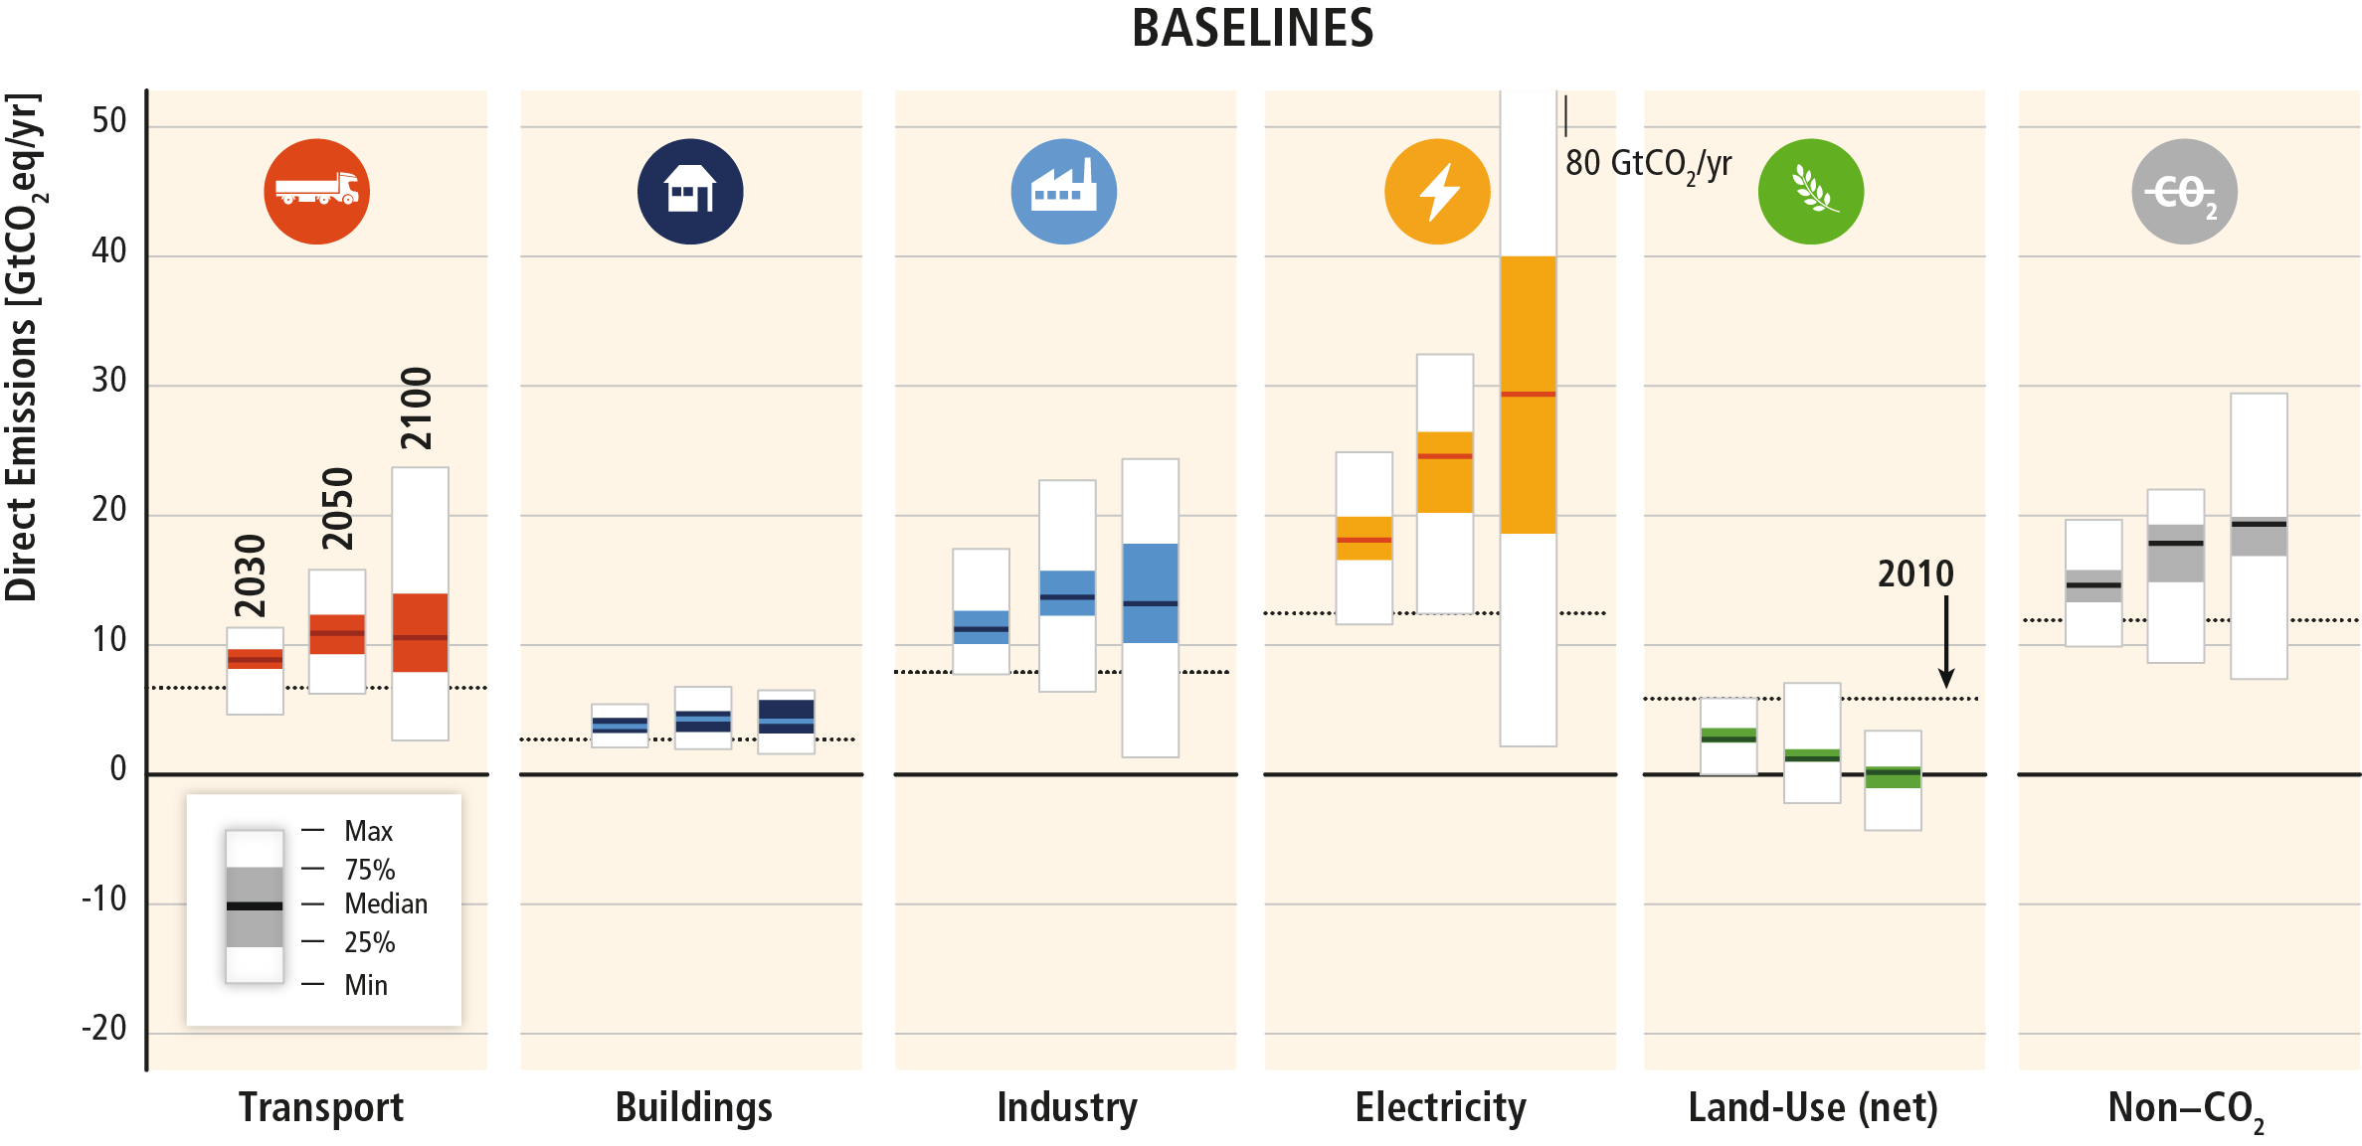
Baseline scenarios suggest rising GHG emissions in all sectors, except for CO2 emissions in the land‐use sector
Notes:
In baseline scenarios, GHG emissions are projected to grow in all sectors, except for net CO2 emissions in the AFOLU sector.
Energy supply sector emissions are expected to continue to be the major source of GHG emissions, ultimately accounting for the significant increases in indirect emissions from electricity use in the buildings and industry sectors.
In baseline scenarios, while non-CO₂ GHG agricultural emissions are projected to increase, net CO₂ emissions from the AFOLU sector decline over time, with some models projecting a net sink towards the end of the century

Slide 19
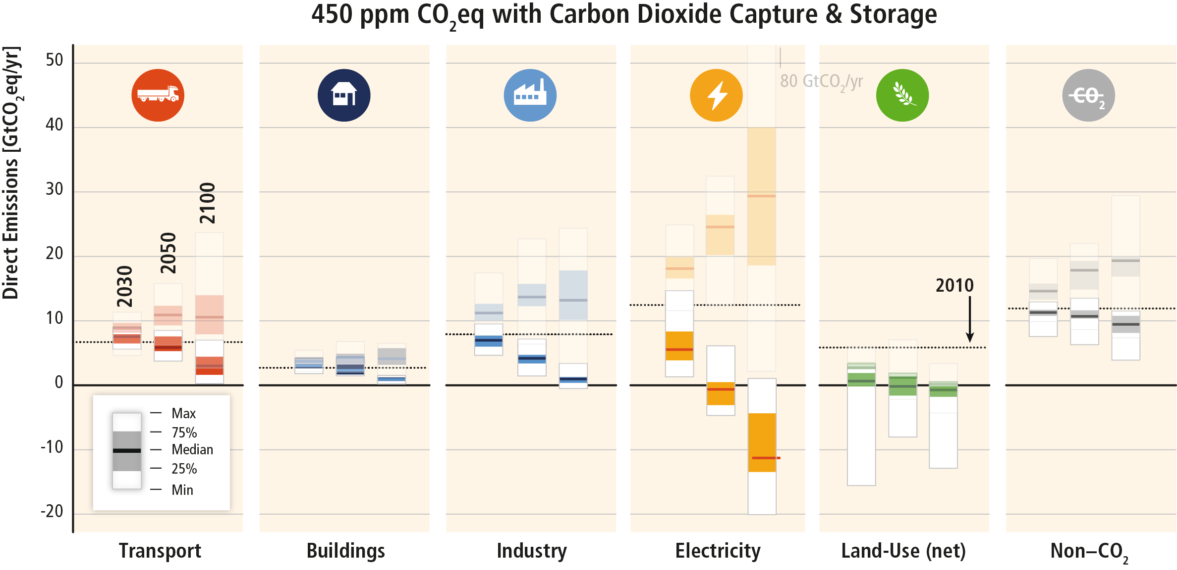
Systemic approaches to mitigation across the economy are expected to be most environmentally and cost effective.
Notes:
Emission need to be reduced from baselines in all sectors in ambitious mitigation scenarios.
Well-designed systemic and cross-sectoral mitigation strategies are more cost-effective in cutting emissions than a focus on individual technologies and sectors. At the energy system level these include reductions in the GHG emission intensity of the energy supply sector, a switch to low-carbon energy carriers (including low-carbon electricity) and reductions in energy demand in the end-use sectors without compromising development

Slide 20
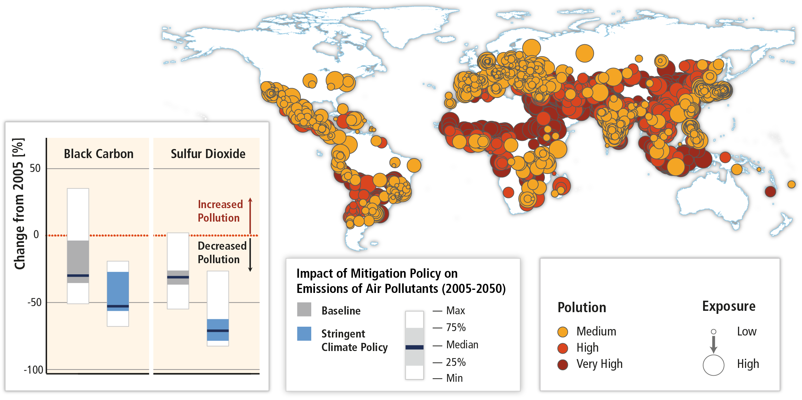
Mitigation can result in large co-benefits for human health and other societal goals.

Slide 21
Key points about co-benefits and adverse side effects
These influences can be substantial, although often difficult to quantify, and have not yet been thoroughly assessed in the literature.
Co-benefits and adverse side-effects depend on local circumstances as well as on the implementation practice, pace and scale.
Behavior, lifestyle and culture have a considerable influence on emissions, with high mitigation potential in some sectors, in particular when complementing technological and structural change.
Enhancing co-benefits and avoiding adverse side-effects: good governance, transparency, stakeholder participation, cross-sectoral analysis and design, etc.

Slide 22
Climate change mitigation is a global commons problem that requires international cooperation and coordination across scales.

Slide 23
Climate change as a global commons problem. Equitable outcomes can lead to more effective cooperation.
No single country can protect “its own” climate by reducing its own emissions.
Countries must persuade other countries to help it solve its climate problem
A country thus reduces its own emissions – and cooperates in other ways – for the sake of inducing reciprocal effort, i.e., getting other countries to do likewise.
A country is more likely to be successful if it is perceived as doing its fair share of the effort.
Thus, a cooperative agreement with equitable effort-sharing is more likely to be agreed and successfully implemented.

Slide 24
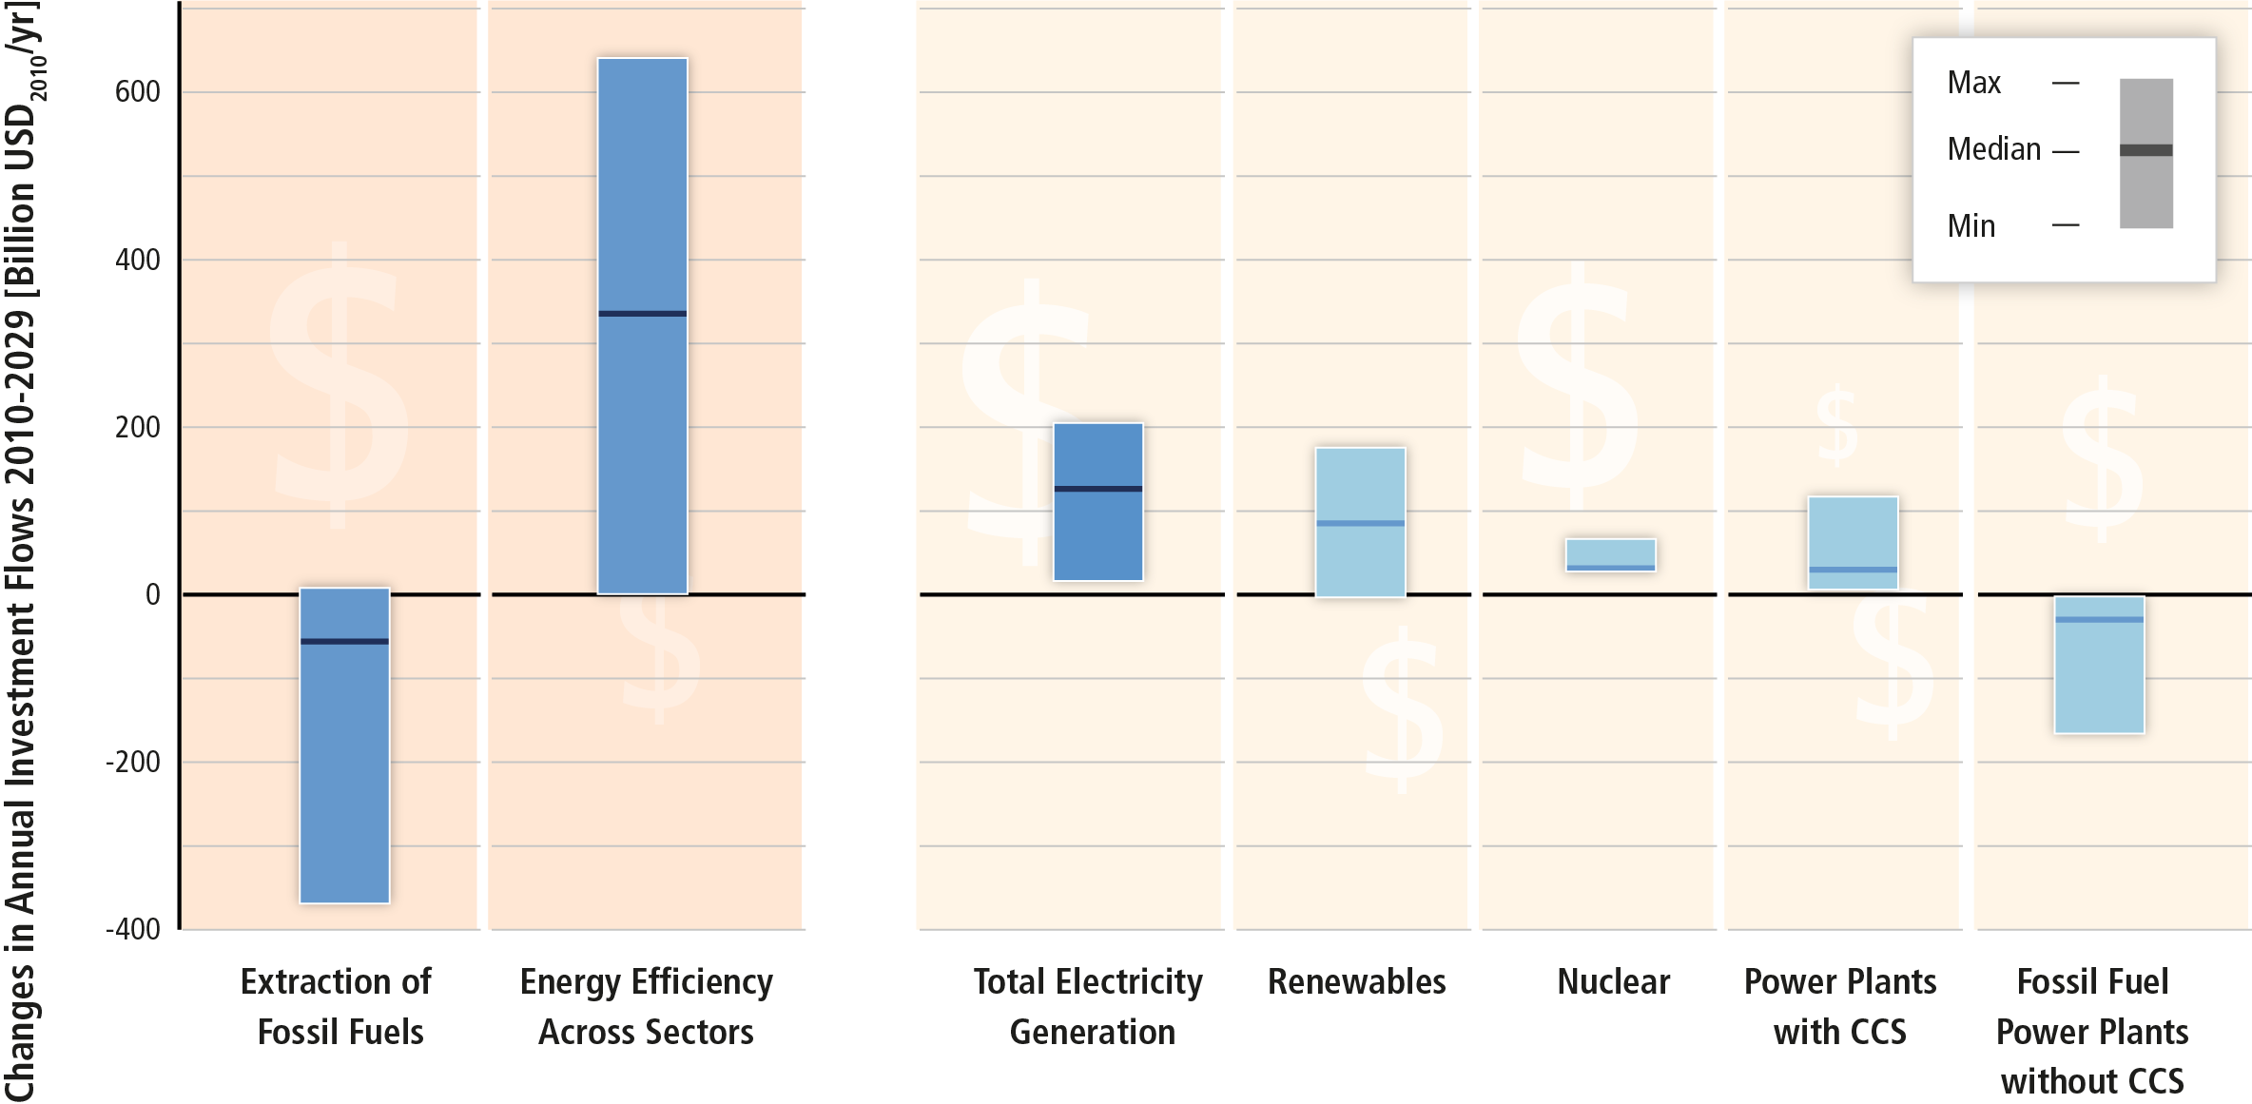
Substantial reductions in emissions would require large changes in investment patterns.

Slide 25
Climate change mitigation is a necessary, but not a sufficient conditions for sustainable development
Effort-sharing is fundamental to international cooperation in a global commons problem.
There is a small set of broadly invoked ethical principles relating to equitable effort-sharing.
Mitigation measures interact broadly (and sometimes strongly) with other sustainable development objectives, creating co-benefits or adverse side-effects.
Highly context specific, difficult to quantify yet nonetheless significant both in welfare and political terms. Managing these interactions implies mainstreaming mitigation.

Slide 26
Overview of findings of AR5 WGIII
www.mitigation2014.org

