Slide 1
A: Overview of project analysis and workshop contributions
July 3, 2013
3:00 pm to 3:30 pm
David Purkey, SEI
Robert Lempert, RAND

Slide 2
Specific Project Objectives
Evaluate (in physical and cost terms) the impacts of climate change on a subset of infrastructures (roads, hydro‐power and irrigation)
Develop and test a framework for investment decision-making that can be ‘robust’ under a wide range of climate outcomes;
Formulate actionable recommendations for decision makers to enhance climate resilience of infrastructure development.

Slide 3
Our Project Team
SEI
RAND
KTH
University of Cape Town
Rhodes University
International Institute for Water and the Environment
The Nile Basin Initiative

Slide 4
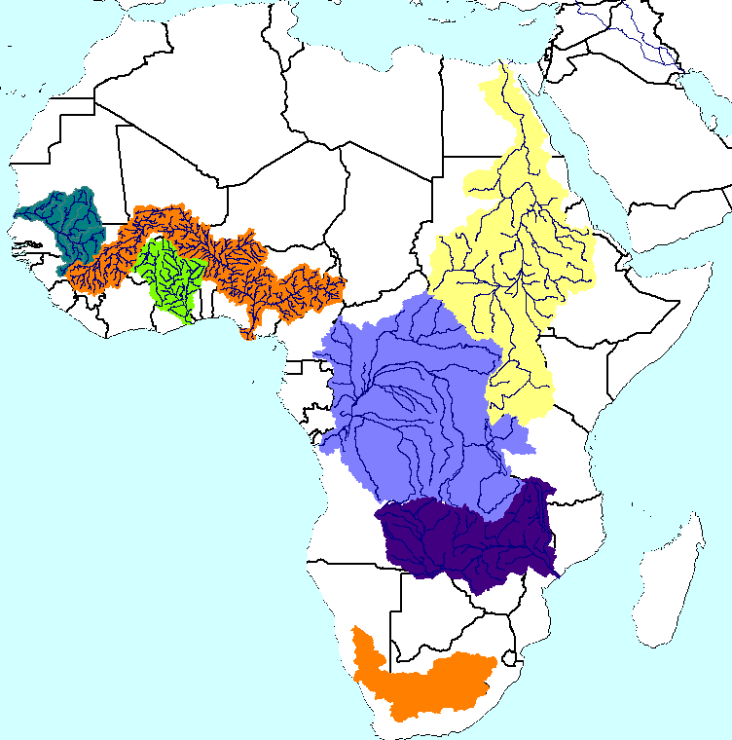
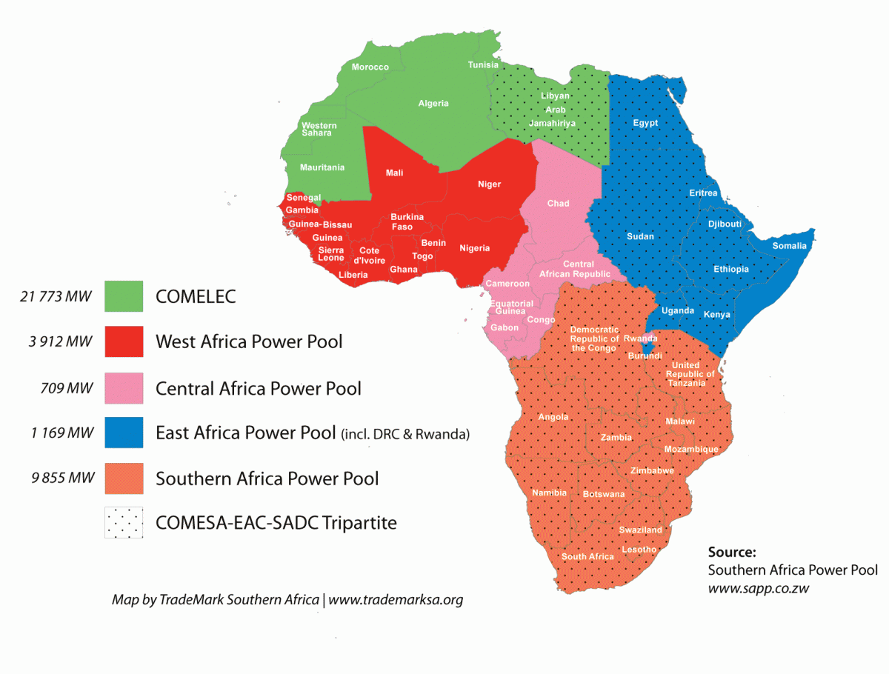
Project Focuses on Continent-Wide Analysis
Seven Water Basins
Four Power Pools
Senegal
Niger
Nile
Volta
Congo
Zambezi
Orange-Senqu
+ Five project level studies

Slide 5
Components of Project Analysis
Infrastructure Investment Plans
Potential Reponses
Impacts
Climate projections and other uncertainties
Use PIDA+ plans
Develop WEAP and GAMs models of the basins and power pools
Use models to assess impacts of climate and other trends on infrastructure and system performance
How to address uncertainty in climate projections (and other trends)?

Slide 6
Use Robust Decision Making (RDM) Approach, Which Runs the Analysis “Backwards”
“RDM Process”
Proposed strategy
Identify vulnerabilities of this strategy
Develop strategy adaptations to reduce vulnerabilities
Start with a proposed strategy
Use multiple model runs to identify conditions that best distinguish futures where strategy does and does not meet its goals
Identify steps that can be taken so strategy may succeed over wider range of futures

Slide 7
RDM Uses Analytics to Facilitate New Conversation with Decision Makers
1. Participatory Scoping
Scenarios and
strategies
New
insights
Vulnerabilities
4. Adaptation Tradeoffs
2. System Evaluation across Many Cases
Outcomes
Vulnerabilities
and leading strategies
3. Vulnerability Assessment
Iterative
Analysis facilitates deliberation among stakeholders
Suggests scenarios and robust strategies
Robust
Strategy

Slide 8
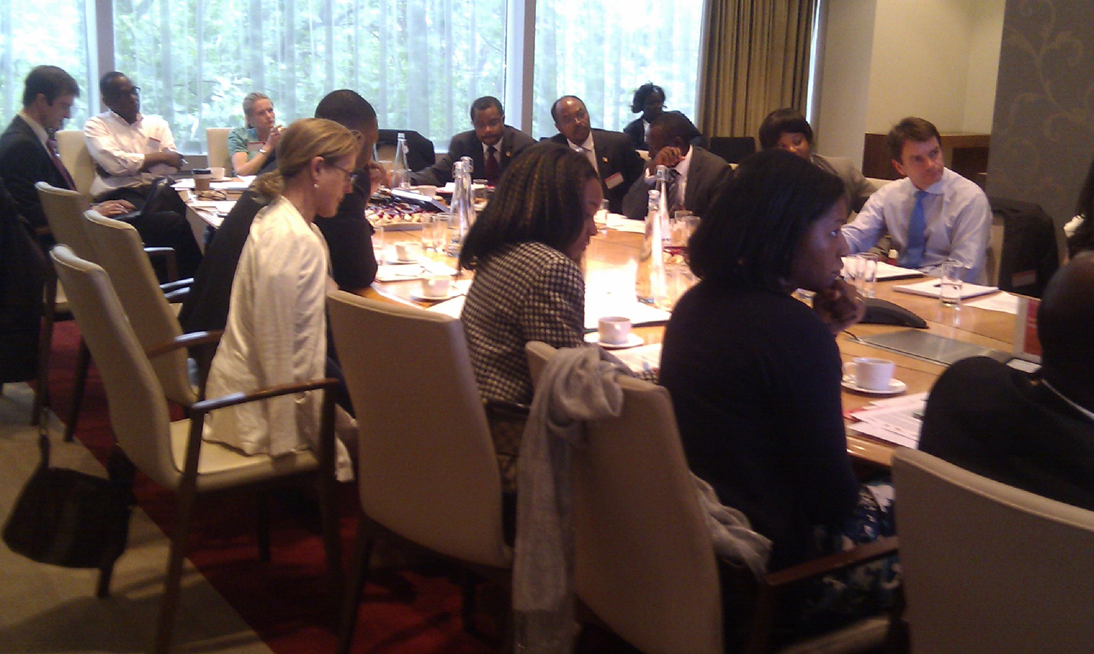
Participatory Scoping: Work with Decision Stakeholders to Define Objectives/Parameters
Deliberation with Decision Stakeholders
Information
needed to organize simulation modeling
1. Participatory Scoping
Metrics that reflect decision makers’ goals
Management strategies (levers) considered to pursue goals
Uncertain factors that may affect ability to reach goals
Relationships among metrics, levers, and uncertainties
Also called “XLRM”

Slide 9
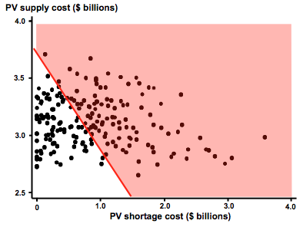
System Evaluation: Evaluate Strategy in Each of Many Plausible Futures
Modeling Futures
Strategy
Plausible assumptions
Potential outcomes
Large database of model results (each element shows performance of a strategy in one future)
2. System Evaluation across Many Cases
100s/1000s of cases

Slide 10
Vulnerability Assessment: Mine the Database of Cases to Identify Policy-Relevant Scenarios
Indicate policy-relevant cases in database of model results
Statistical analysis finds low-dimensional clusters with high density of these cases
Uncertain input variable 2
.
.
.
.
. . .. .
.
.
Scenarios that illuminate vulnerabilities of proposed strategy
3. Vulnerability Assessment
Strategy successful
Uncertain input variable 1
Parameter 2
Clusters represent scenarios and driving forces of interest to decision makers
Strategy less successful
Parameter 1

Slide 11
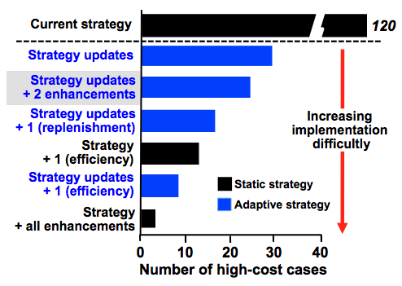
Tradeoff Analysis: Allow Decision Makers to Compare Tradeoff Among Strategies
Visualization helps decision makers
compare strategies
Robust strategy or information to enable decision-makers to make more robust strategy
4. Tradeoff
Analysis

Slide 12
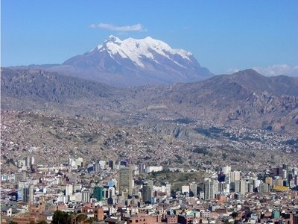
La Paz/El Alto Bolivia Case Study

Slide 13
Current Water Supply System for the Cities of La Paz and El Alto, Bolivia

Slide 14
Infrastructure Alternative No. 1
New Khara Kkota (14M) dam
Increase Taypichaca (8M) dam to 18M m³
New 400 l/s Khara Kkota canal to El Alto
New 400 l/s Taypichaca canal to El Alto

Slide 15
Infrastructure Alternative No. 2
Increase Taypichaca dam capacity from 8M to 18M m³
New water capture structures in Janchallani and Jacha Waquiwina watersheds to the Taypichaca Dam
New 800 l/s Taypichaca canal to El Alto

Slide 16
Infrastructure Alternative No. 3
New Kaluyo dam of 10.6M m³
New water capture structure in the Chacaltaya watershed to the Kaluyo Dam
New 1000 l/s Kaluyo canal to La Paz
New 800 l/s Milluni canal to El Alto

Slide 17
Modeling the alternatives in WEAP

Slide 18
“XLRM” Framework to support problem formulation and analytical design
Uncertainty Factors (X) | Response Packages (L)
Uncertain factors outside of the control of water managers which form the basis of scenarios analysis. | Management strategies available to water managers: Current system Planned strategies
Models (R) | Performance Metrics (M)
Models to produce metrics of performance (M) for each strategy (L) in the face of ensembles of uncertainties (X) | Results of interest, metrics used to evaluate the performance of strategies under consideration

Slide 19
Resulting XLRM table
Uncertainty Factors (X) | Response Packages (L)
Climate change and vulnerability Population growth Per capita water use Changes in water allocation policy Growth in irrigated areas | Infrastructure Alternatives 1, 2 and 3 Source watershed conservation plans Increased irrigation efficiency Reduce losses in potable water distribution system
Model (R) | Performance Metrics (M)
 | Satisfaction of potable water demands Satisfaction of irrigation water demands System losses Reservoir storage

Slide 20
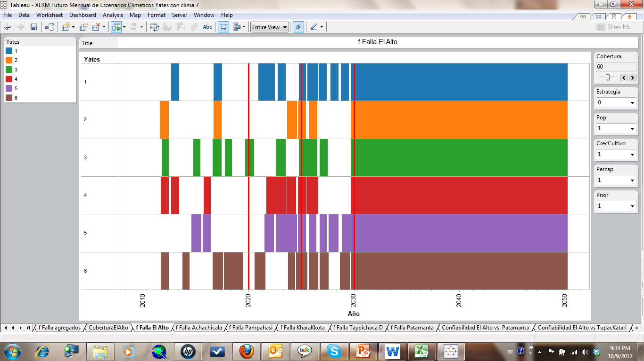
Frequency of failure to meet at least 80% of potable water demand in El Alto

Slide 21
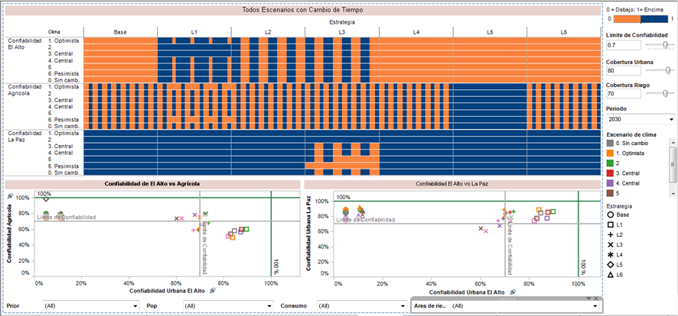
Bringing it all together, in Spanish

Slide 22
Outcome of the Effort
In an iterative cycle of modeling, analysis, and interaction with decision makers, arrived a preferred alternative.
The preferred alternative included elements of Alternative 1 and 2, along with investments in source watershed rehabilitation and irrigation improvements investments.
This preferred alternative is now the focus of environmental documentation, design, and financial planning efforts.

