Slide 1
ORANGE- SENQU OVERVIEW

Slide 2
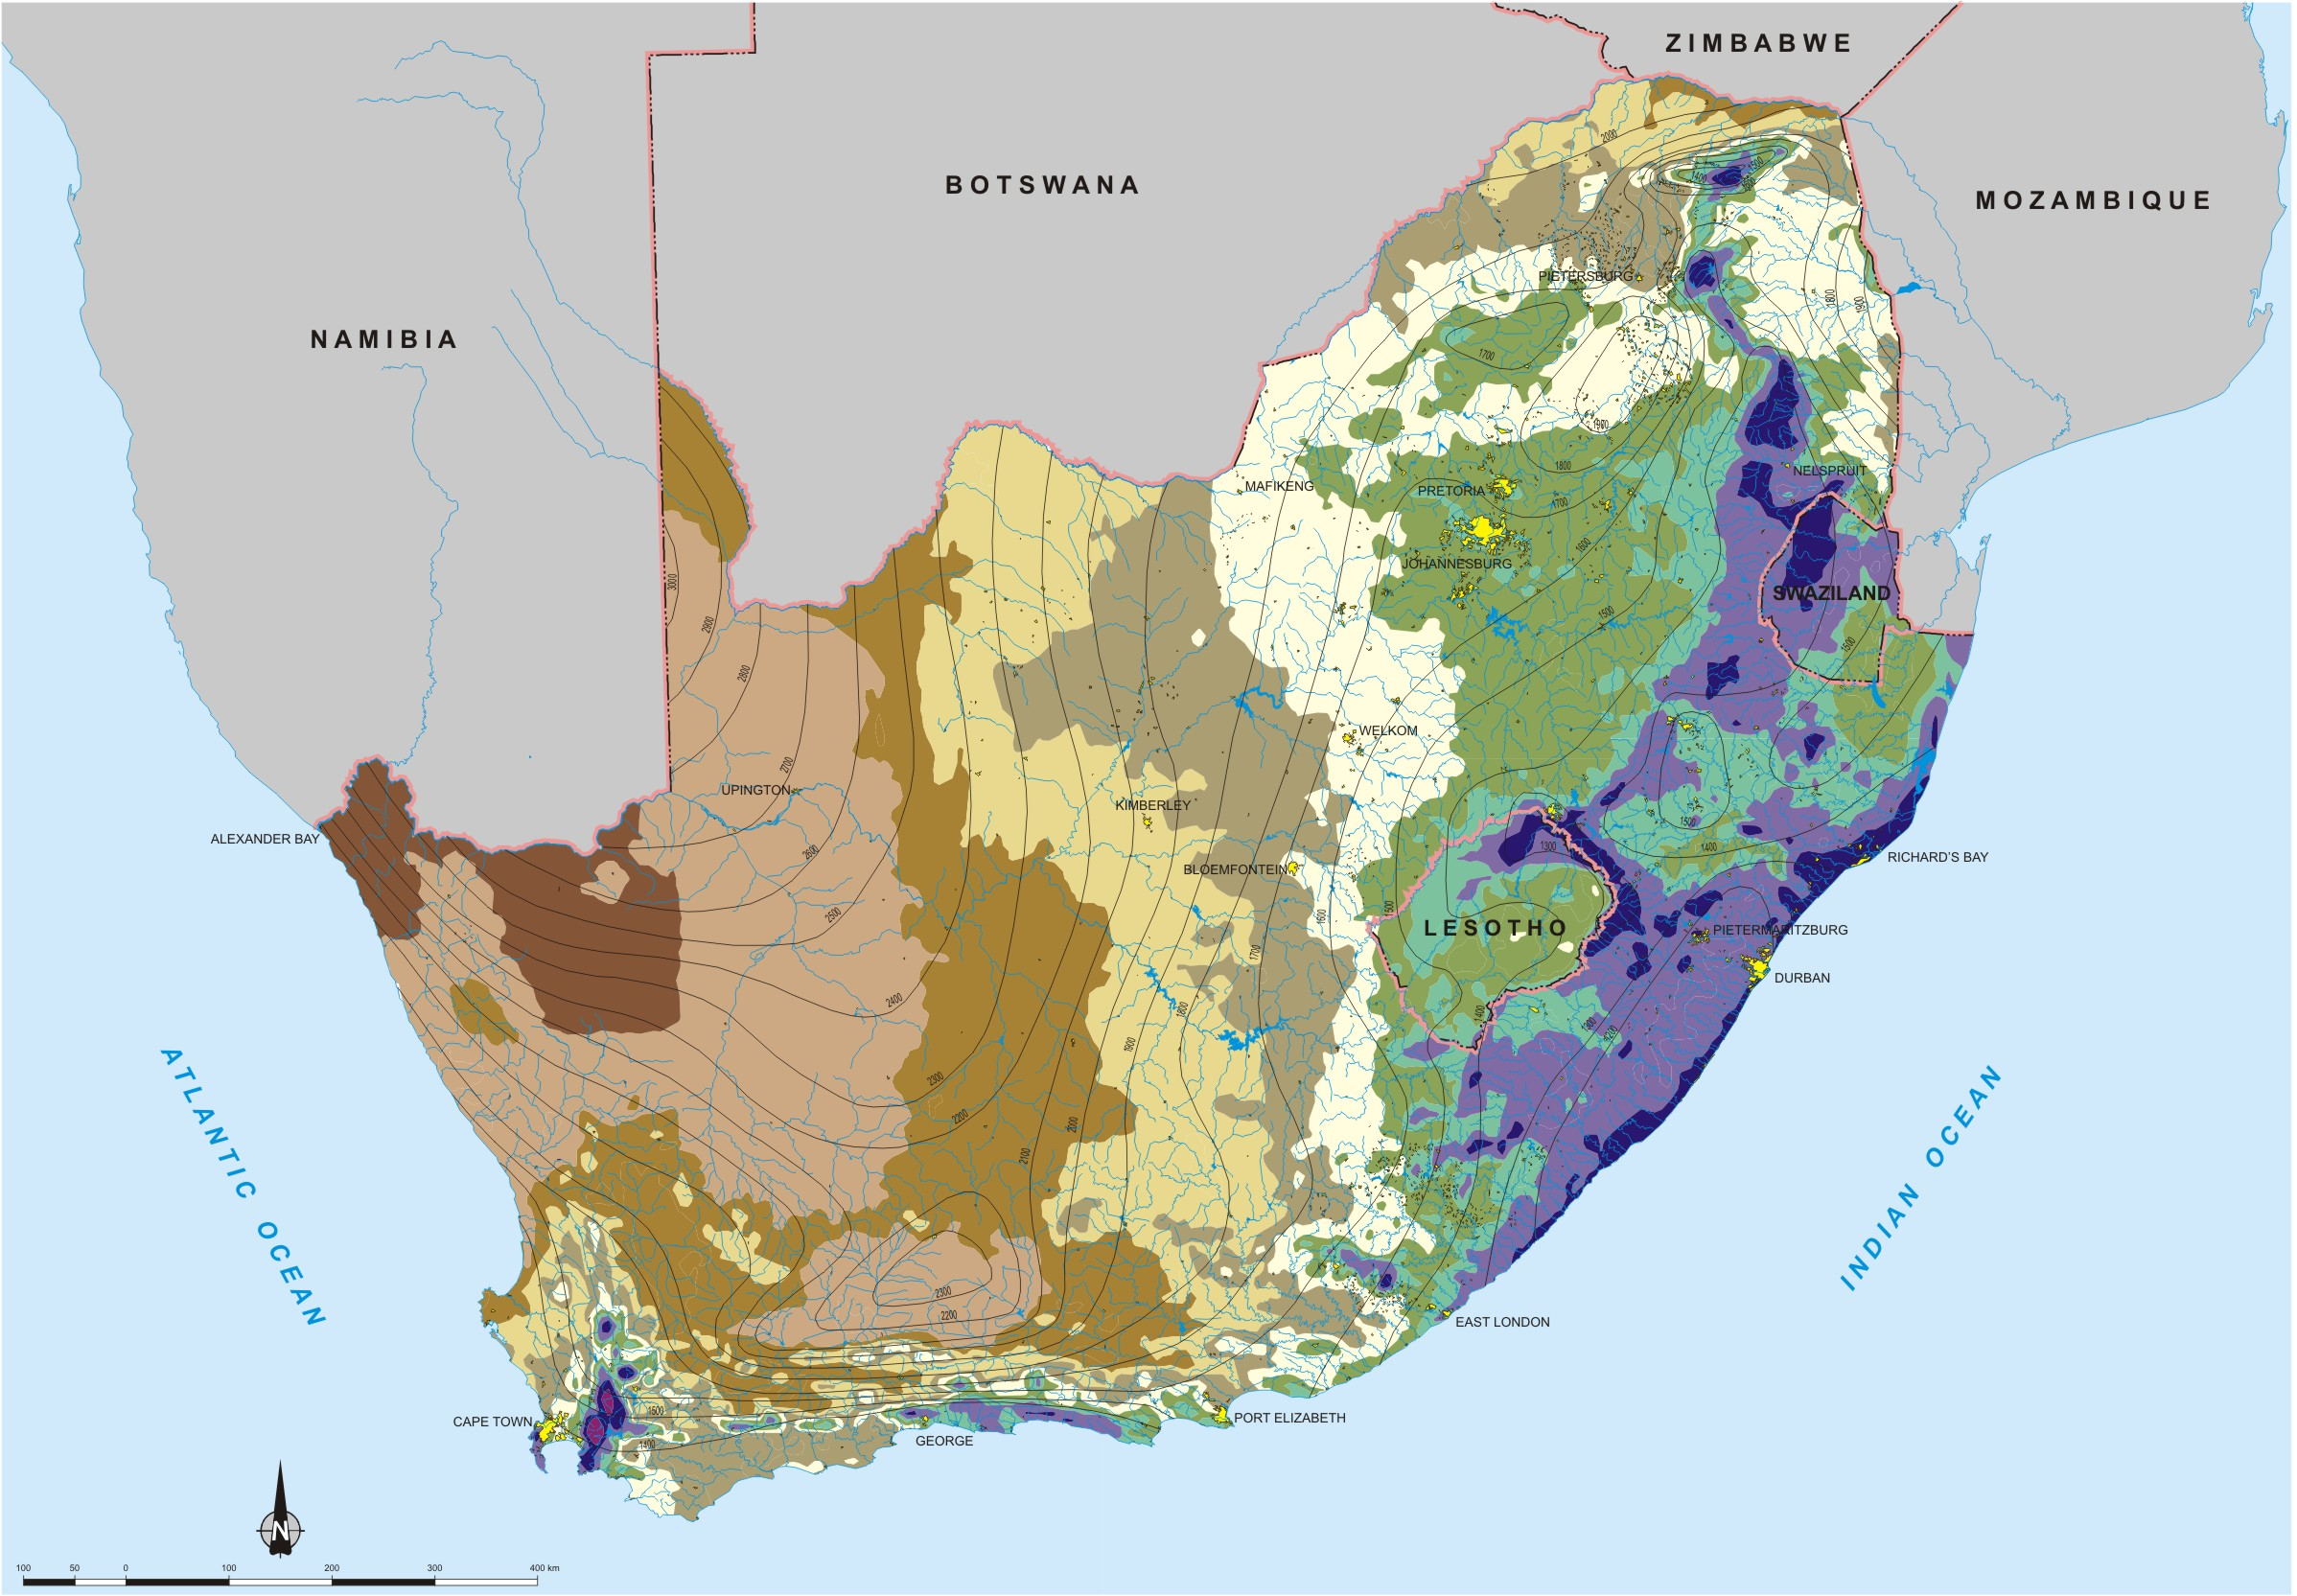

Slide 4
Motivation for large dams
Dams store water from flood years for droughts
Carry over periods may be up to 7 years
Evaporation is substantial
Yields much less than mean annual run-off

Slide 5
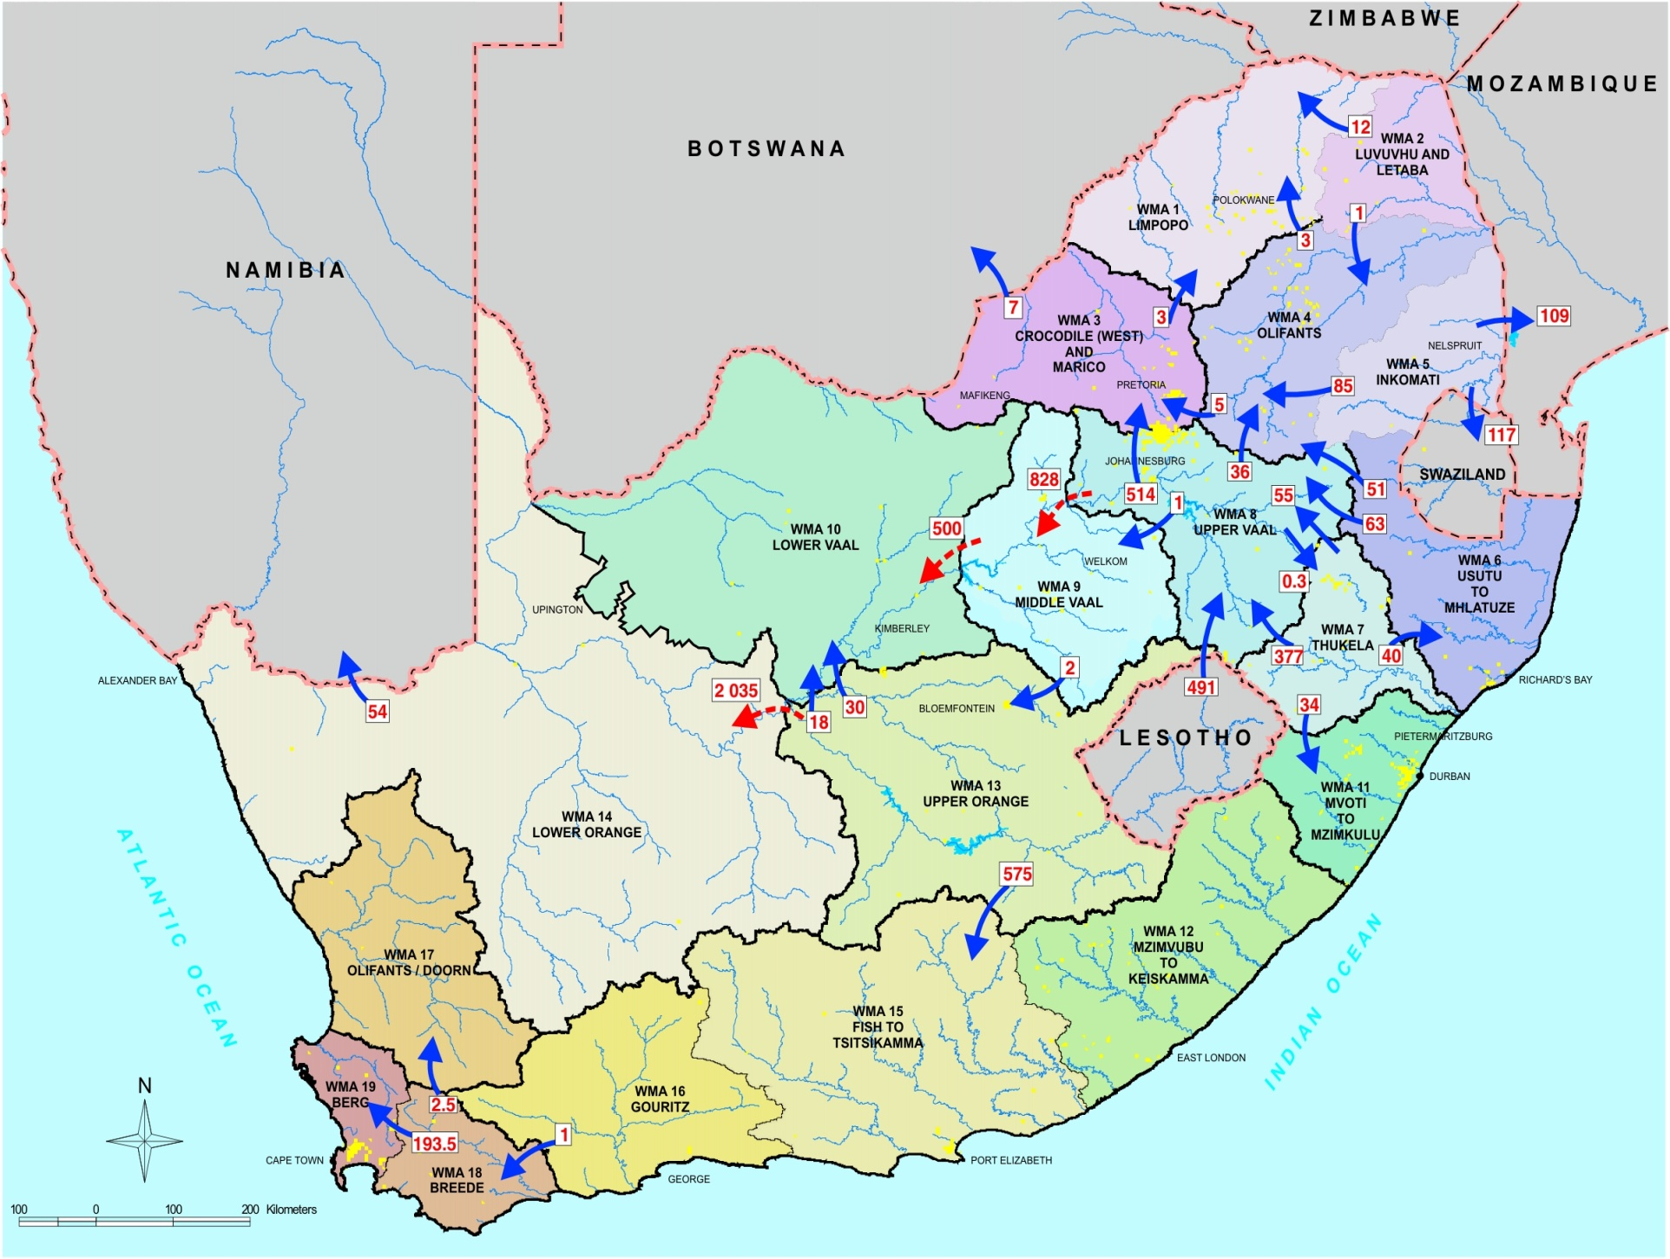
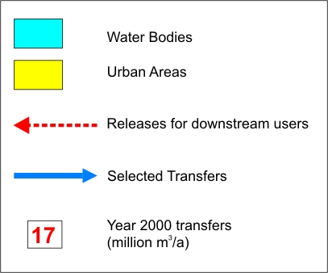
Water Management Areas and Main Water Transfers
Notes:
Country subdivided into 19 WMAs to better address local conditions and to facilitate improved management of resources.
Mention that more information will be given later in the day on Cathment Management Agencies, as managing authorities for WMAs.
WMAs designated by catchment boundaries, not following provincial boundaries.
By considering national averages only, important details and differences can often be masked. Therefore even WMAs divided into sub-areas as will later be shown.
Note transfers to overcome imbalances between geographic occurrence and requirements for water (some WMAs interlinked by river).
(More detail on imbalances in slides to follow.)
Mzimvubu to Keiskamma WMA is only one in country not linked through transfers to another WMA.
Advise audience that more detail available in Appendix D of NWRS and in WMA reports.

