Slide 1
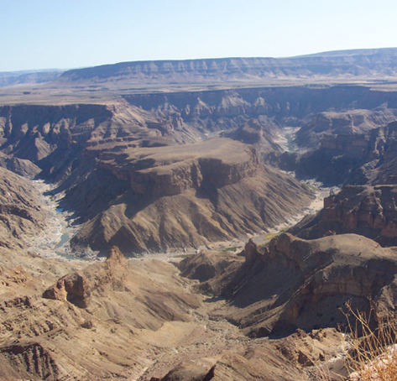
OVERVIEW
NAMIBIA

Slide 3
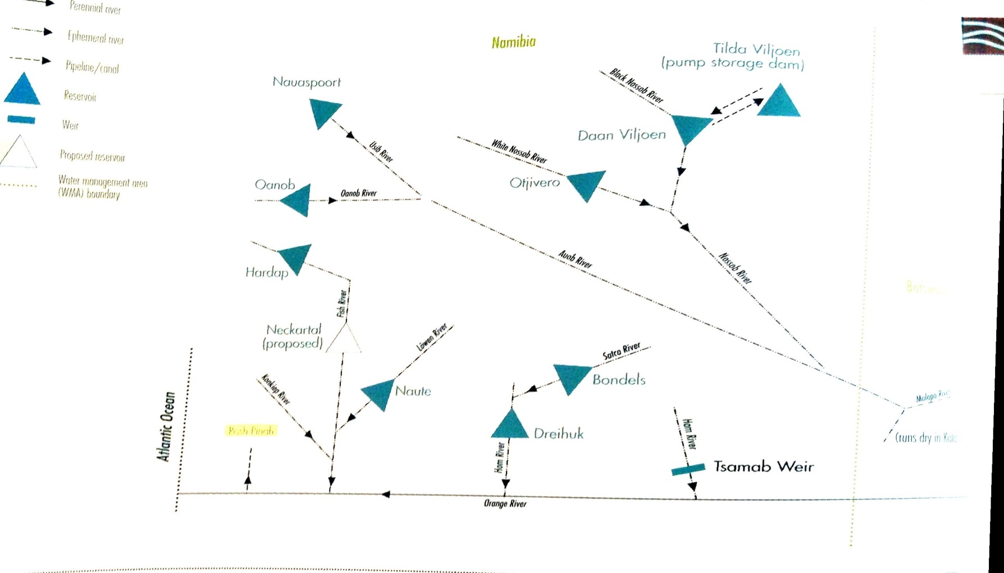
Current & Future Developments in Namibia

Slide 4
Current & Future Developments in Namibia
Dam Name | River | FSC in Mm³
Bondels | Satco | 1.09
Daan Viljoen | Black Nossob | 0.43
Dreihuk | Ham | 15.49
Hardap | Fish | 294.60 (206.10)
Nauaspoort | Usib | 3.19
Naute | Loewen | 83.58
Neckertal | Fish | 857
Oanob | Oanob | 35.51
Otjivero | White Nossob | 9.8 main dam 7.8 silt
Tilda Viljoen | Black Nossob | 1.25
Lower Orange Re-regulating

