Slide 1







Addressing the Climate Vulnerability of African Infrastructure
Introduction
Raffaello Cervigni and Marcus Wishart (World Bank)
July 3, 2013

Slide 2
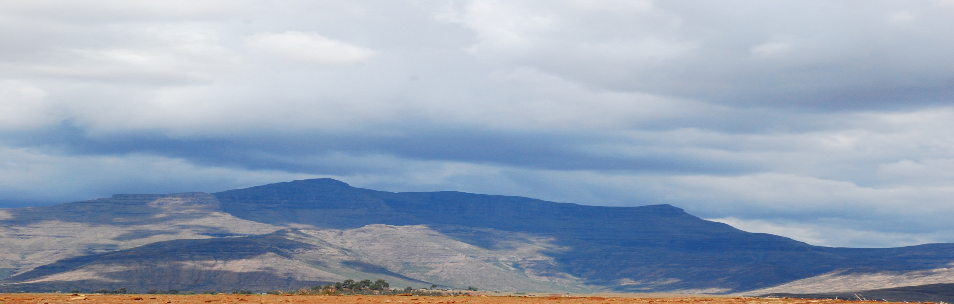
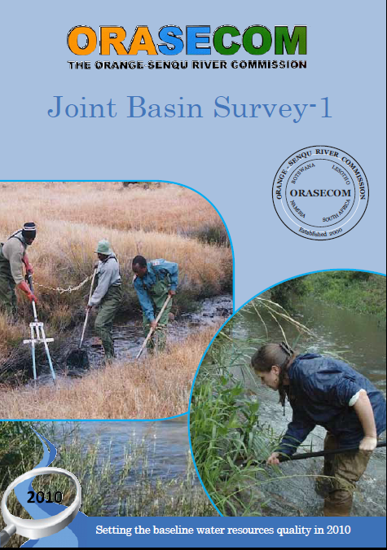
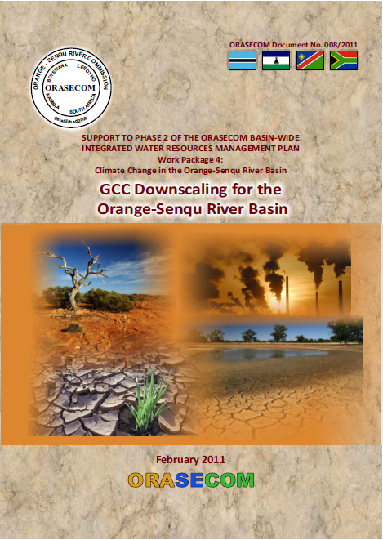

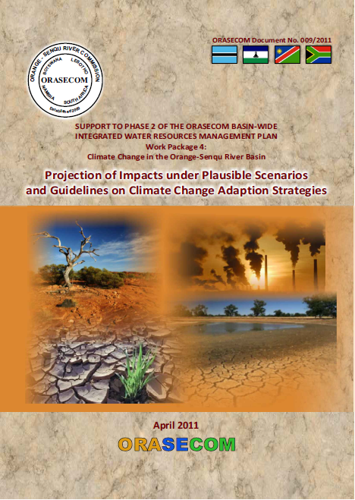
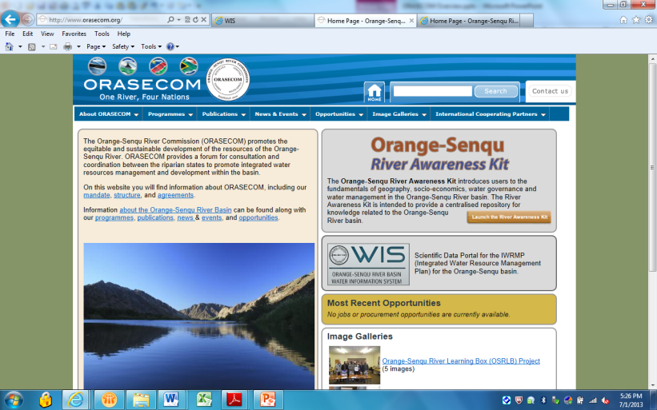
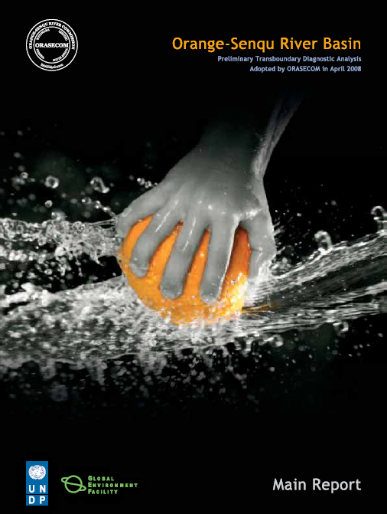
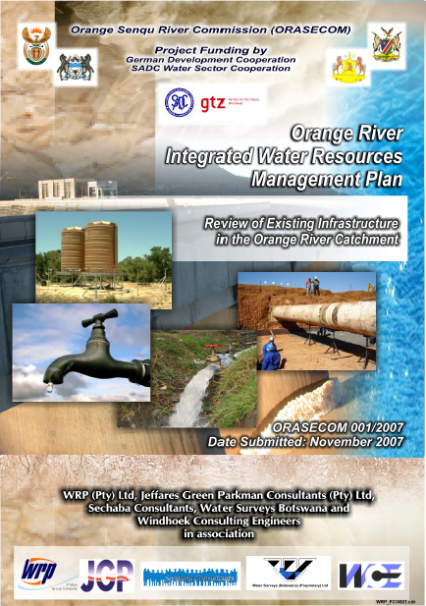
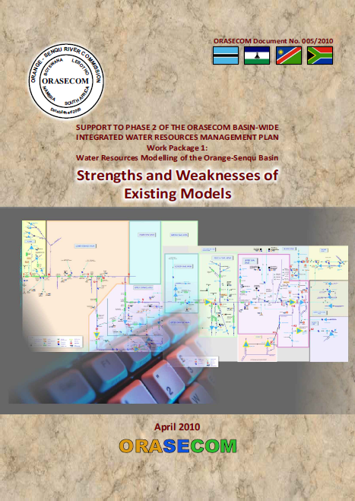
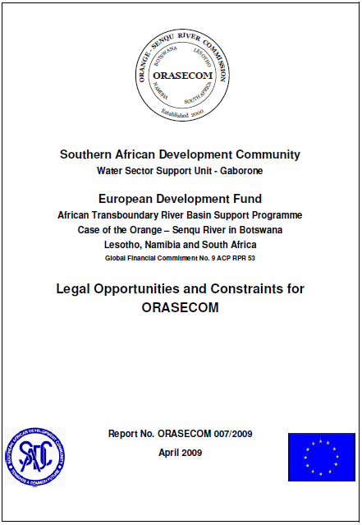
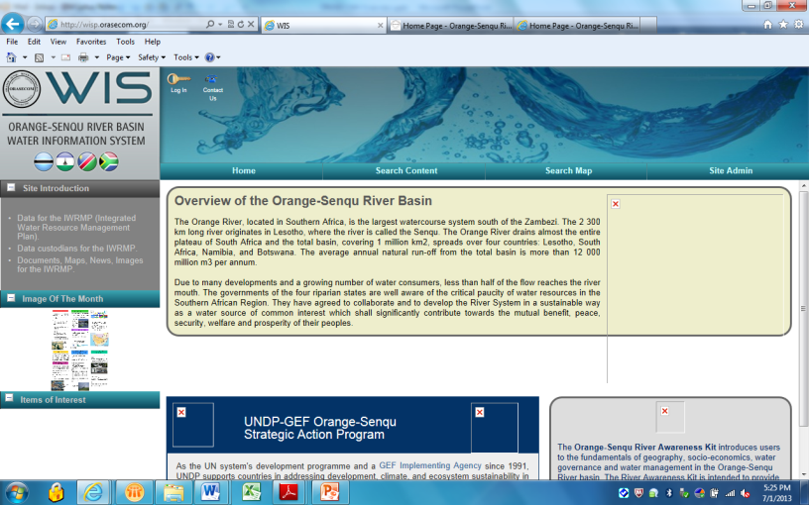
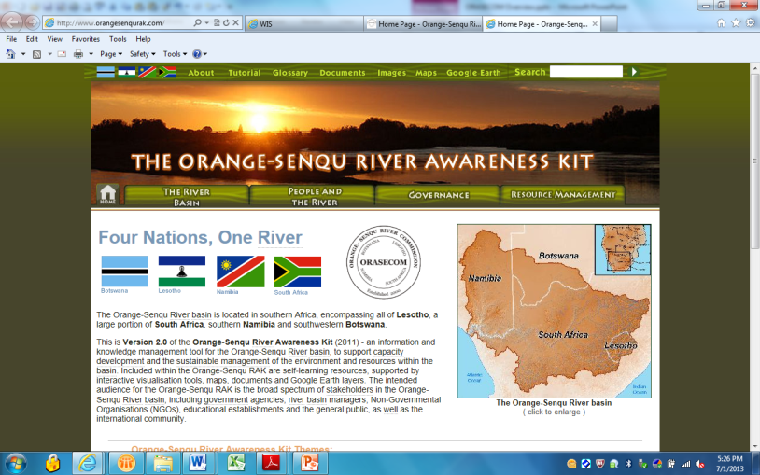
Existing Body of Knowledge

Slide 3
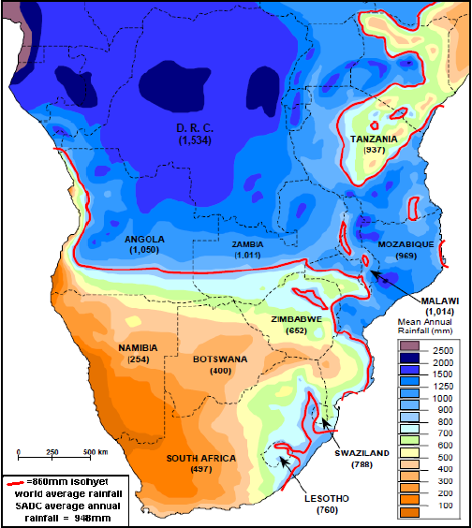
Current Context & Value Added ?
Africa wide comparative assessment
        Quantify CC impacts on performance of network infrastructure;
        Identify, evaluate and cost robust adaptation approaches for planning, evaluating, and designing specific infrastructure investments in the face of climate uncertainty;
        Formulate actionable recommendations for policy makers on how to enhance the climate resilience of infrastructure development and mobilize the required resources.
Orange-Senqu accounts for over 10% of Africa’s GDP
3rd most economically important basin in Africa
Regional WBG Portfolio of activities
          Lesotho Water Sector Improvement Project
          Lesotho Highlands – Botswana Water Transfer Study
          Lesotho CC Scenario Analysis to Strengthen Economic Planning (GFDRR)

Slide 4
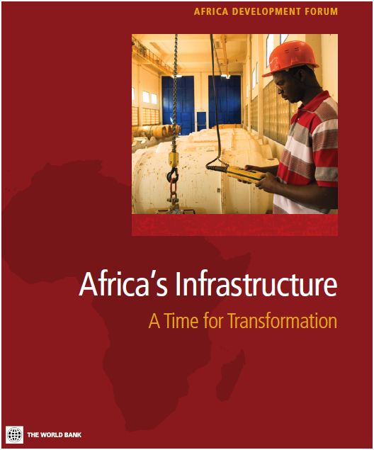
Starting points: Africa Infrastructure Country Diagnostic (AICD)…
Comprehensive overview of current infrastructure status, policy, institutional and financial challenges
Concludes that Africa needs to spend US$93bn pa to catch-up on infrastructure with rest of developing world
Estimates made under a “no climate change” presumption

Slide 5
Key finding: $93 billion financing needs, $31 billion gap to fill
Source: Africa Infrastructure Country Diagnostic (AICD)

Slide 6
..and Program for Infrastructure development in Africa (PIDA)
Sector | Target by 2040
Modern highways | 37,300 km
Modern railways | 30,200 km
Port capacity | 1.3 billion tons
Hydroelectric power generation | 54,150 MW
Interconnecting power lines | 16,500 km
New water storage capacity | 20,101 hm3
$68 billion

Slide 7
What happens with climate change?

Slide 8
Main implications
Can no longer plan and design infrastructures as we did in the past: risk of “regrets”
Need new approaches to deal with the changing, but uncertain, climate of the future
Might need to incur higher costs

Slide 9
Why a new study?
Few existing national, sub-regional and regional infrastructure development plans address climate change implications
Existing studies on climate change tend to:
  Focus on impact
  Address one sector at a time
  Provide limited project-level insights on adaptation responses
Climate science is evolving

Slide 10
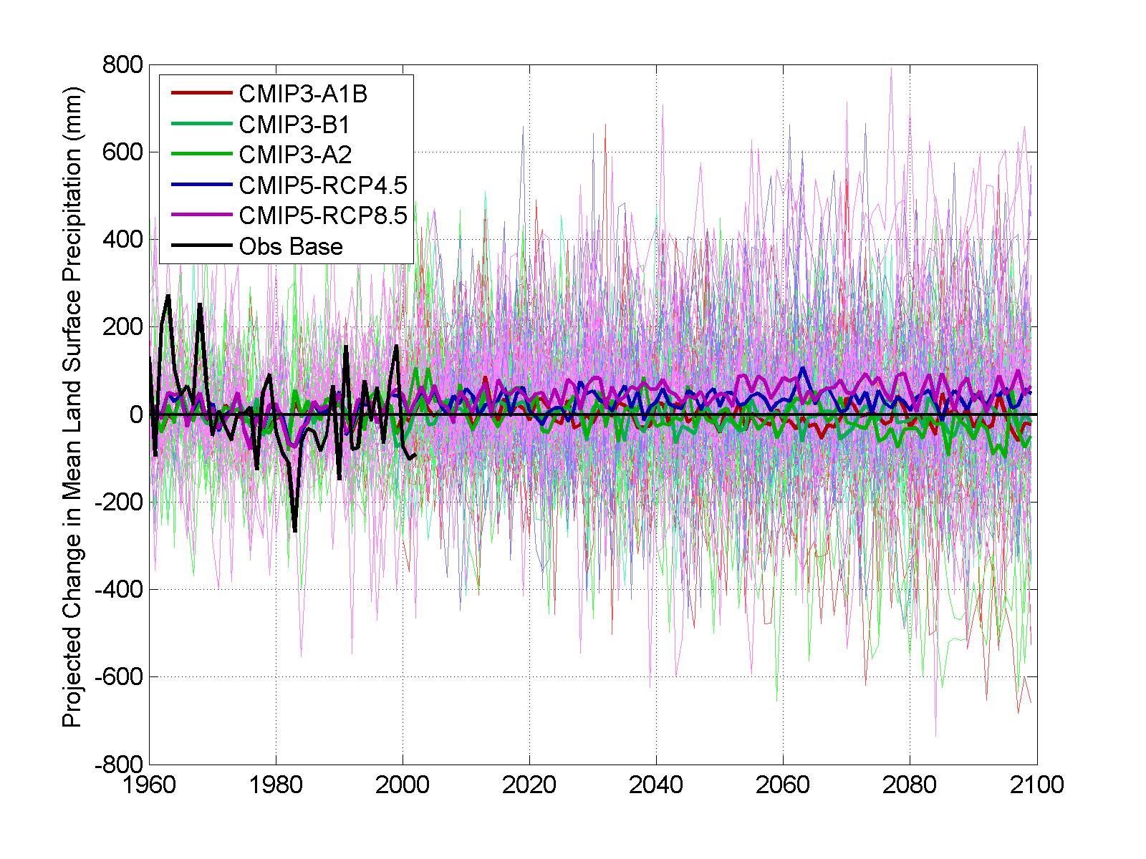
Climate science: consensus on change, uncertainty on direction/ magnitude
Return to main slide show
Notes:
A wide range of available annual average precipitation forecasts, shown here for the Volta basin area

Slide 11
Why a regional approach?
Economies of scale in knowledge generation
Regional/ sub regional infrastructure integration
Informing dialogue on development/ climate finance (e.g. IDA, Climate Negotiations)

Slide 12
A partnership to support investments in Africa’s infrastructure under an uncertain future climate
Donors
DFID
Nordic Dev Fund
Germany (KfW)
France (AFD)
BNPP
TFESSD
Partners
AU/NEPAD/AfDB
RECs
RBOs
Power Pools
Others?
Implementation
World Bank;
Africa Climate Policy Center (UNECA)

Slide 13
Overall objective
“Strengthen the analytical base for investments in Africa’s infrastructure under a future uncertain climate, to facilitate and support climate resilient infrastructure development.”

Slide 14
Specific Objectives
Evaluate (in physical and cost terms) the impacts of climate change on a subset of infrastructures (roads, hydro‐power and irrigation)
Develop and test a framework for investment decision-making that can be ‘robust’ under a wide range of climate outcomes;
Formulate actionable recommendations for decision makers to enhance climate resilience of infrastructure development.

Slide 15
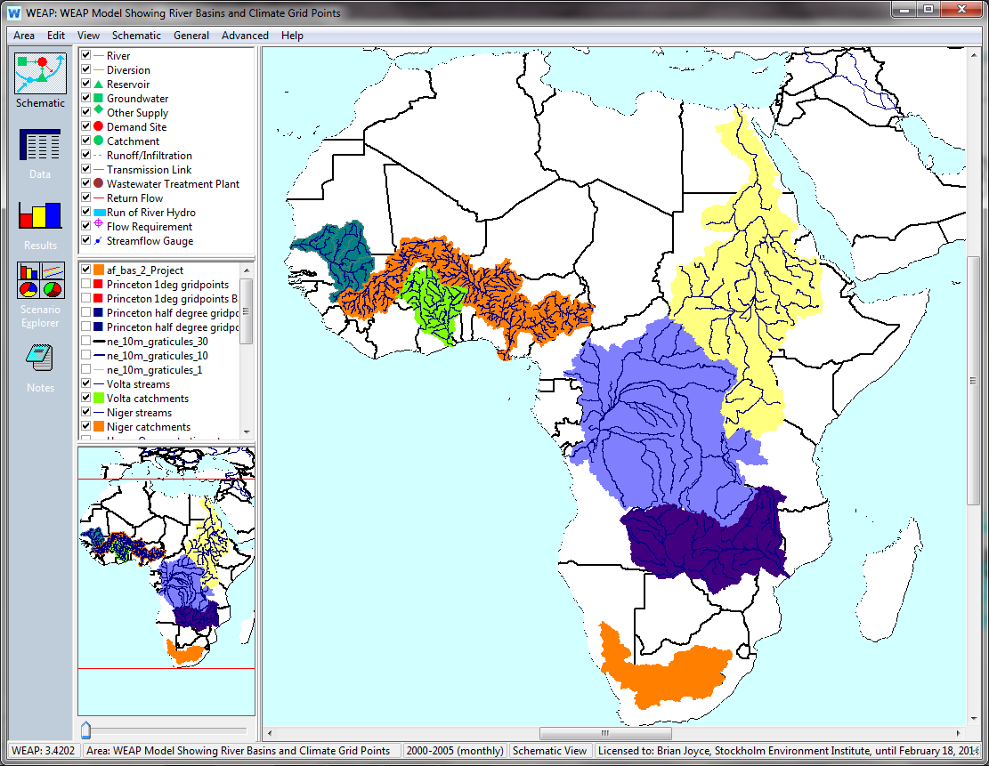
Scope: Seven Major River Basins…
Senegal
Nile
Niger
Volta
Congo
Zambezi
Orange

Slide 16
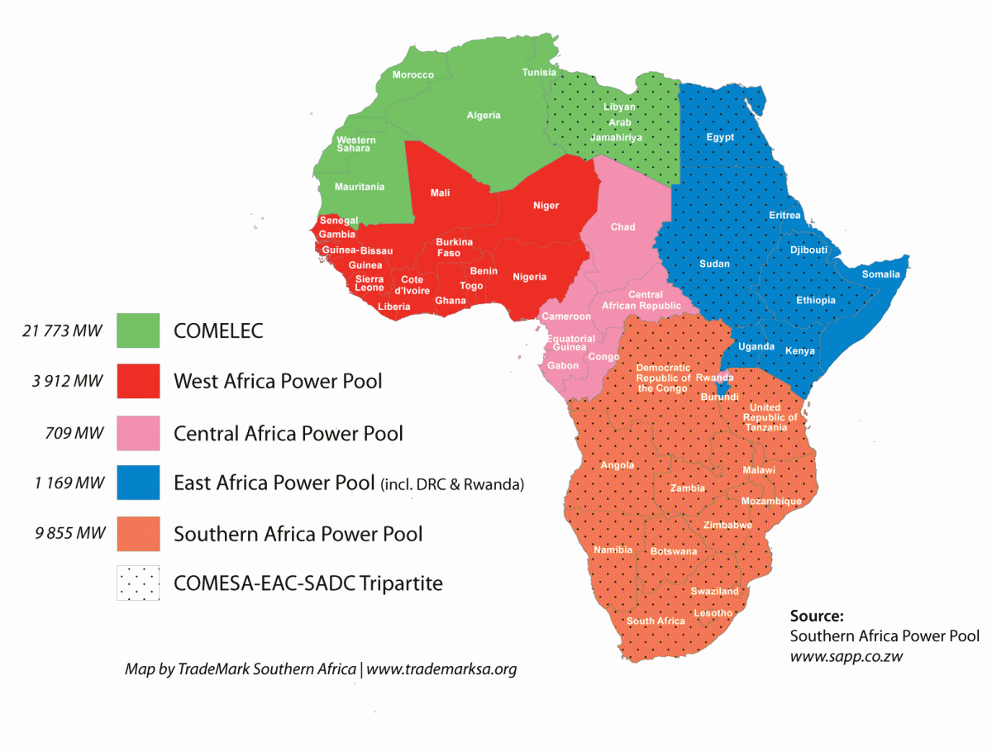
… four Power Pools..

Slide 17
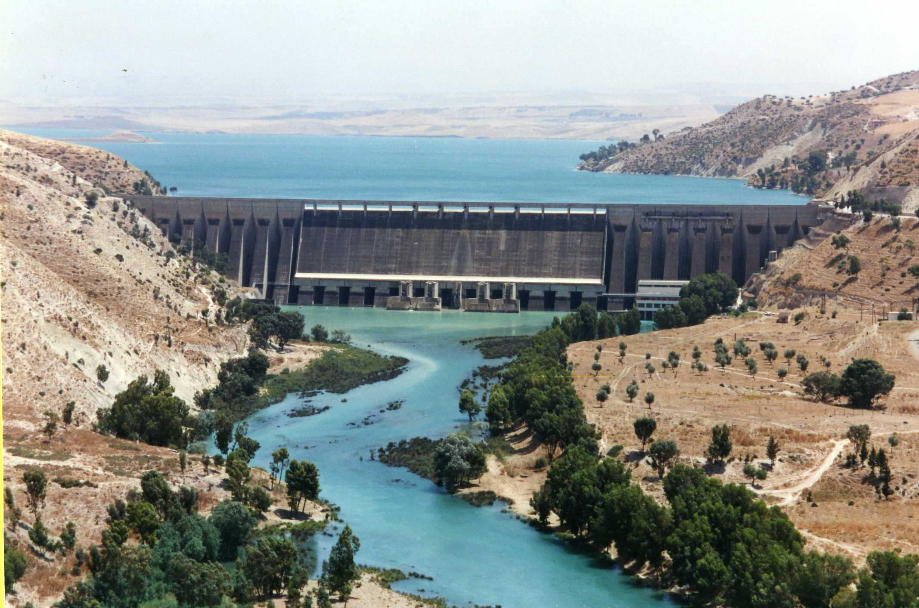
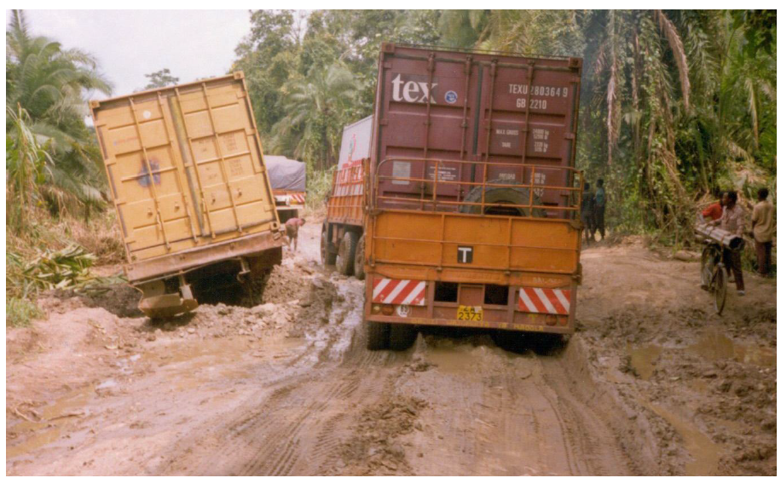
..and five types of infrastructures
Municipal water supply
Irrigation
Hydro-power
Other power sources
Roads

Slide 18
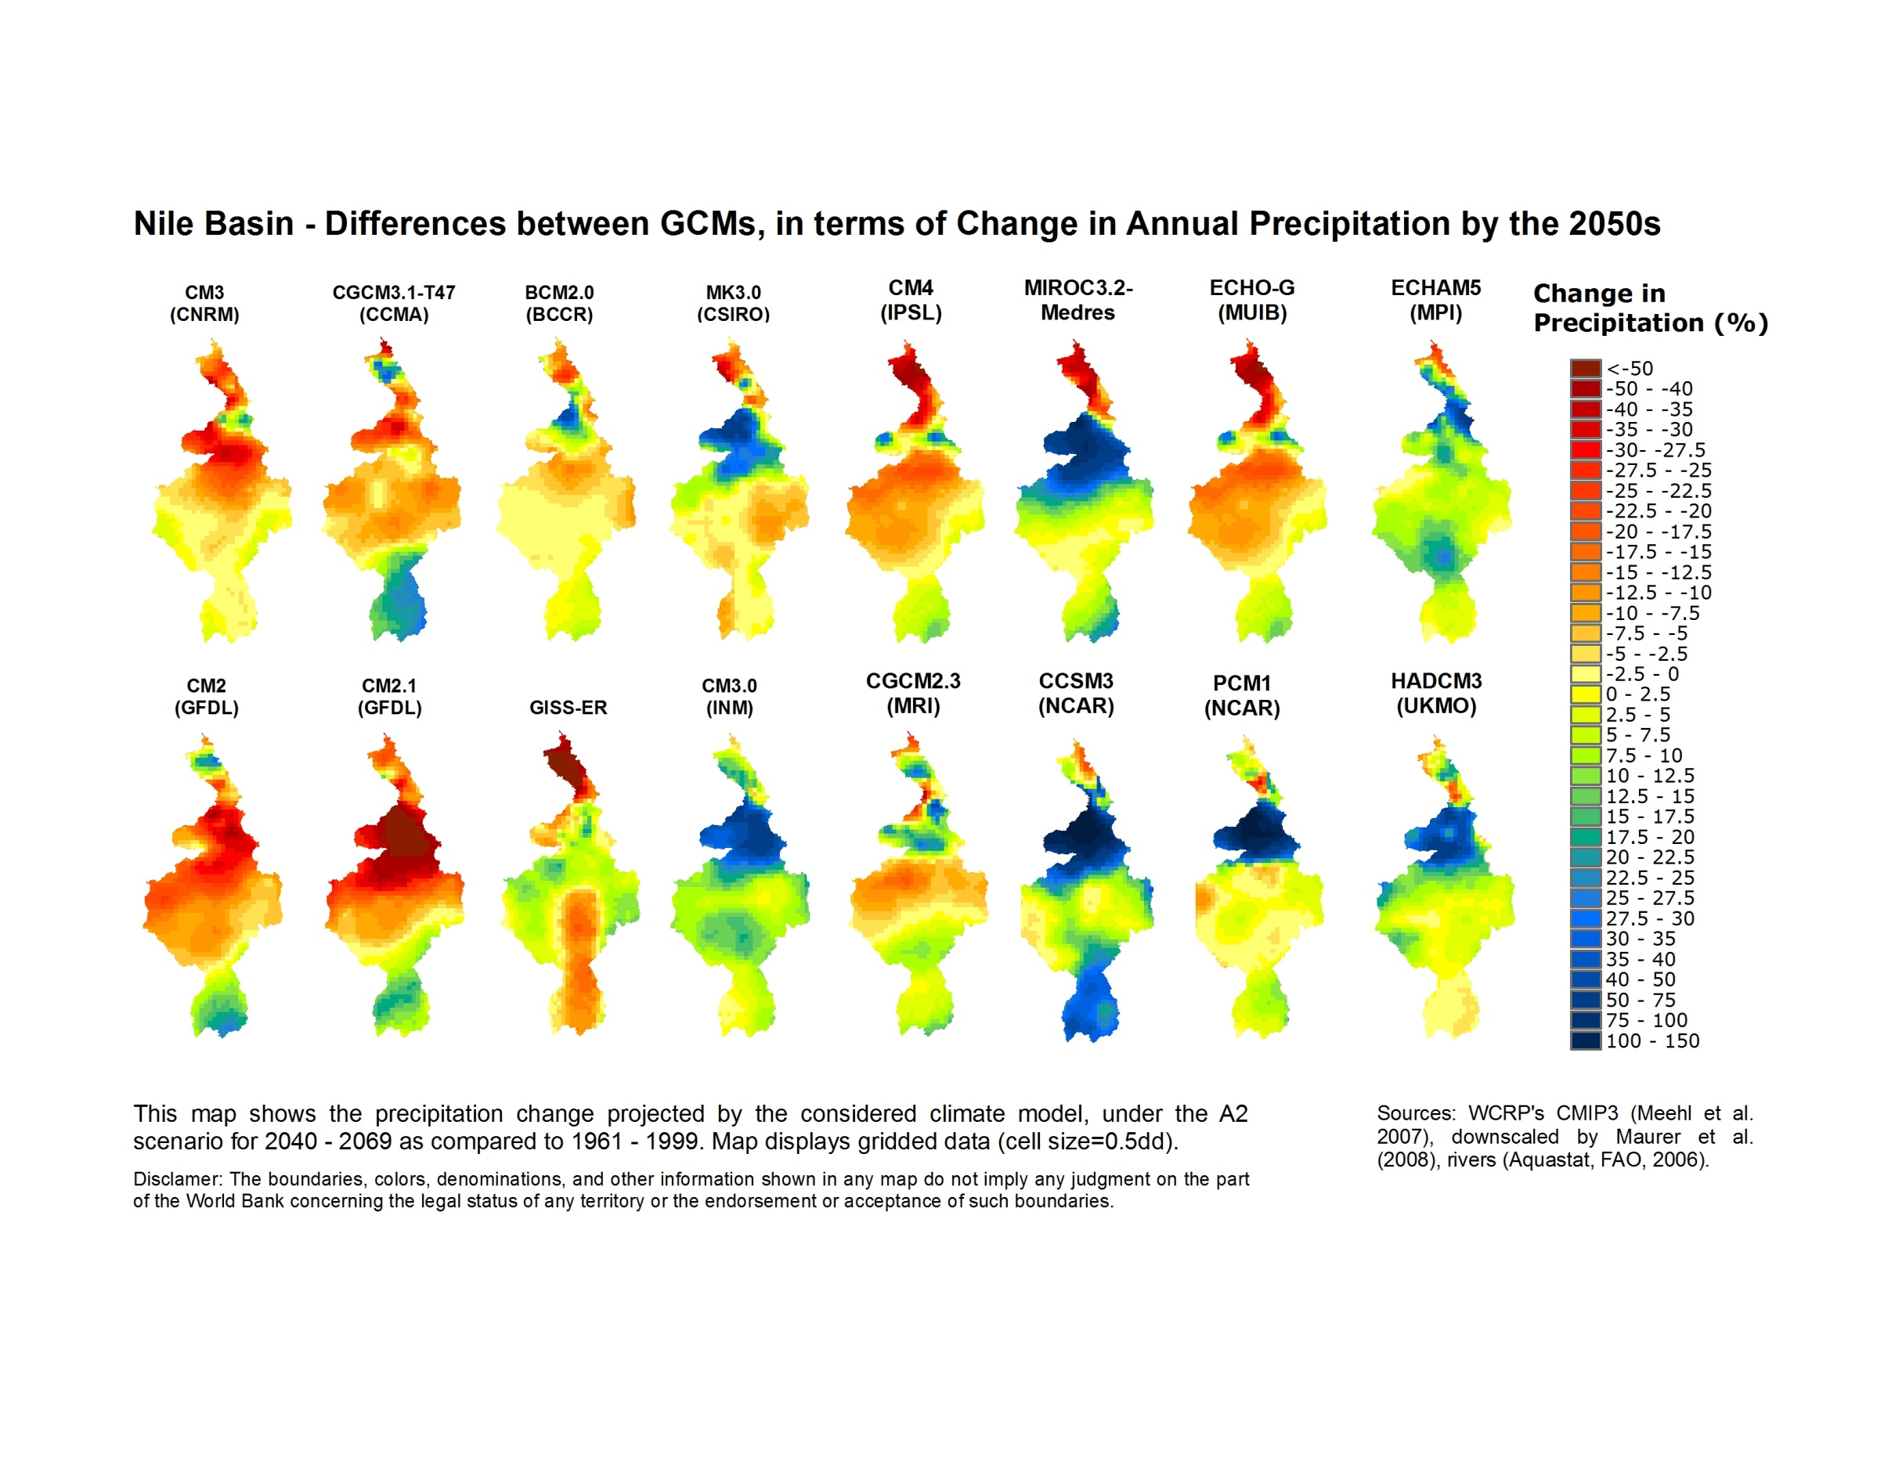
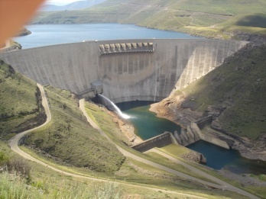
Two tracks of analysis
Track 1: coarser scale (basins and power pools)
  Emphasis on planning, trade-offs among policy objectives
Track 2: specific investments scale
  Emphasis on project design options

Slide 19
Overview of approach
Define a set of development targets
  PIDA
  Other plans
Define a reference case (no climate change)
  Use historical climate
Evaluate deviations (+/-) from target under a wide range of climate scenarios (including IPCC AR5)
Analyze (including costs) options to minimize risk of not achieving targets through “Robust Decision-making” (RDM):
  At basin/ power pool scale (track 1)
  At investment level scale (track 2)
Value added:
  Consistent regional approach to impact analysis
  Innovative treatment of uncertainty in adaptation analysis

Slide 20
Progress to date
Stock taking of relevant initiatives/ data (including baseline plans)
Definition of a conceptual and modeling framework
First set of results: Volta Basin, Southern Africa Power Pool

Slide 21
Track 2: provisional list of case studies
Countries | Case study
Kenya | Mombasa Water Supply
DRC | Inga 3
Malawi | Fufu hydropower
Ghana | Pwalugu multi-purpose dam
Burkina Faso | Numba multi-purpose dam
Guinea/ Sierra Leone | Boureya dam
Senegal/ Mali | Senegal River Navigability Project

Slide 22
Next steps
2012: scoping of work, stock-taking, fund-raising
2013, July: start road component ; interim report
August – Dec
  Workshops: Volta, follow-up Orange (proposed)
  Track 1 analysis in other river basins
  Energy analysis in other power pools
  Track 2 case studies
2014: Jan-March: report preparation
May: review
Summer: dissemination

Slide 23
Workshop Objectives
PREMISE: Orange-Senqu: advanced stage of planning/ modeling, thus excellent sounding board for proposed approach
OBJECTIVES:
Present, and elicit feedback on:
  Modeling tools (hydrology, power) proposed for analysis
  Decision analysis framework proposed to evaluate potential climate impacts on investment decisions
Discuss options for follow-up collaboration, including:
  Options for project-level (track 2) analysis of climate resilience
  Workshop after the summer to discuss advanced Orange/Senqu specific results

Slide 24
Workshop Agenda
July 3rd afternoon
  Presentations from country delegations
  Overview of framework of study
  The modeling tools (hydrology, power)
July 4th, morning
  Participatory scoping of Orange-Senqu analysis
  Illustrative applications (focus on the Volta basin)
July 4th, afternoon
  Project level analysis of climate resilience
  Next steps

